Slide 1
MCB 4211
Sept 24, 2020
Lecture 8

Slide 2
Monoclonal Antibody production (continued)
How does a genome that encodes about 22,000 polypeptides encode millions of antibodies?
Reading: Immunobiology textbook Chapter 5: “The generation of lymphocyte antigen receptors”
A. Genetics of antibody synthesis (the B cell receptor)
B. Generation of antibody diversity
1. germline vs. somatic mutation
associational, junctional and combinatorial diversity
C. Class (isotype) switching

Slide 3
How to immortalize a single B cell clone in order to make a single, clonal antibody that can be produced in vitro in limitless supply

Slide 4
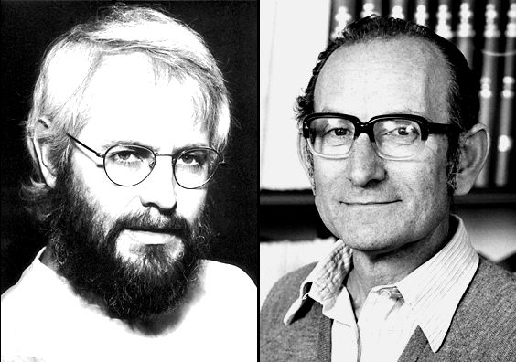
Kohler, G. and Milstein, C., Continuous cultures of fused cells secreting antibody of predefined specificity. Nature, 1975. 256: p. 495-7. http://www.nature.com/nature/journal/v256/n5517/pdf/256495a0.pdf
NOBEL PRIZE IN 1984 FOR THIS DISCOVERY
Global Cancer Monoclonal Antibodies Market was worth USD 41.3 billion in 2019 and is predicted to grow USD 70.6 billion by the end of 2024.
https://www.marketdataforecast.com/market-reports/global-monoclonal-antibodies-market

Slide 5
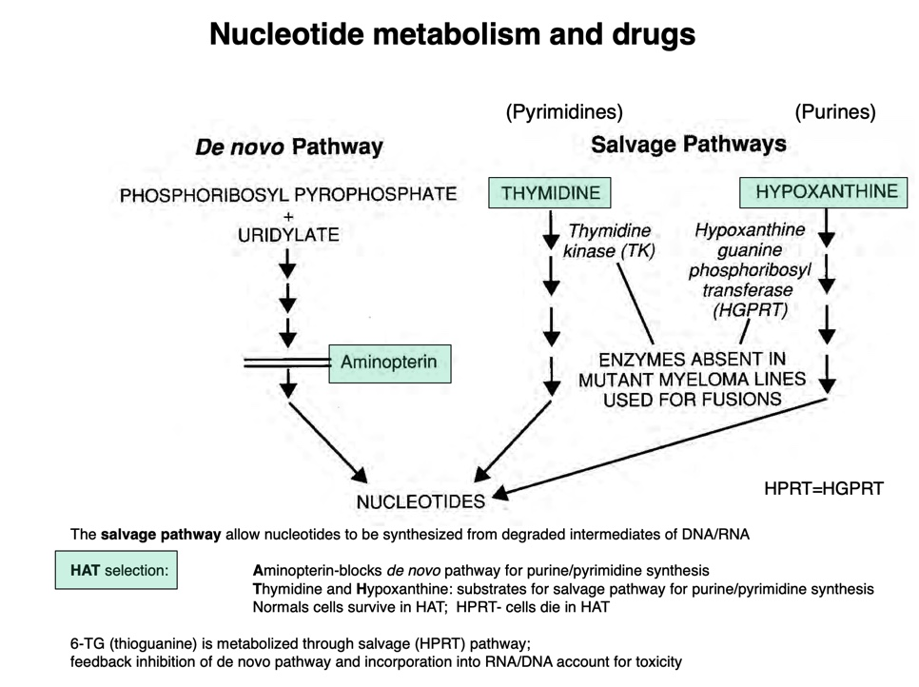
http://www.its.caltech.edu/~bich113/PDFs/Lectures/16_intracellular_signaling.pdf

Slide 7
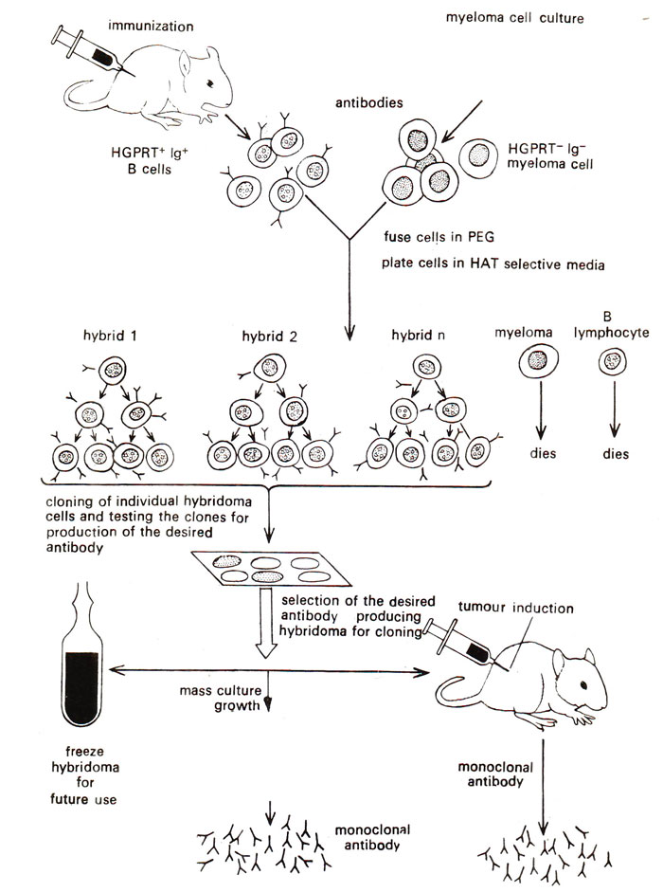

Slide 8
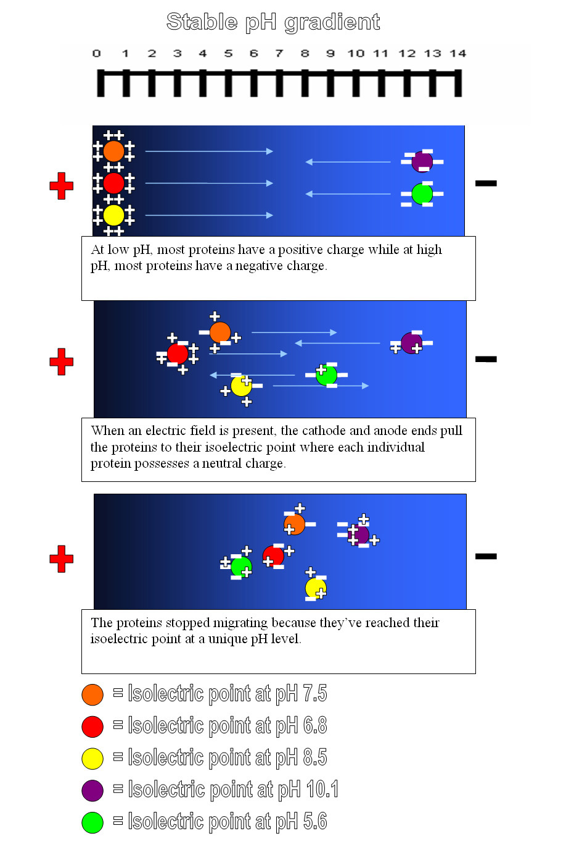
https://en.wikipedia.org/wiki/Isoelectric_focusing

Slide 9
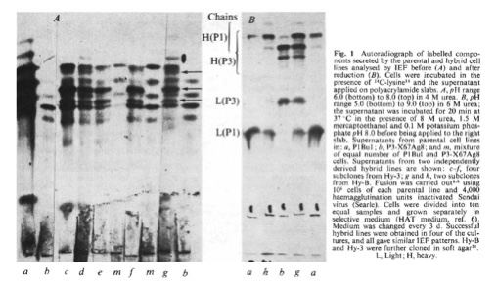

Slide 10
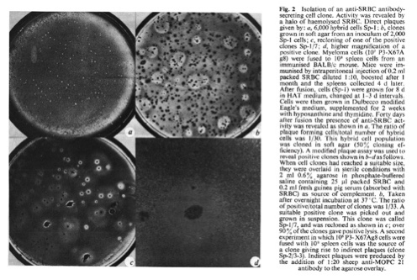

Slide 12
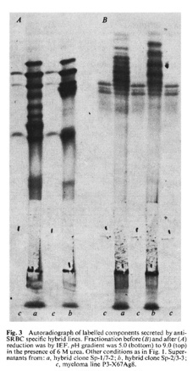

Slide 13
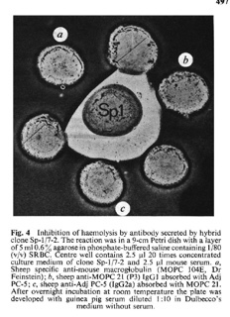

Slide 14
Using mouse antibodies as therapeutics in humans will provoke anti-mouse antibodies. These human anti-mouse antibodies will block the therapeutic mouse antibody, and the immune complexes that are formed will filter to and accumulate in the kidneys. These immune complexes then will activate complement and form the membrane attack complex that can insert in nearby kidney cells. This kidney damage (called “serum sickness” from the days in WWI when horse antibodies were used therapeutically) can be quite severe.
Beginning in 1914, (about 10 years before the discovery of antibiotics) in the British and French armies, tetanus antiserum (made in horses injected with modified tetanus toxin was routinely given to patients with dirt-contaminated wounds. Serum sickness developed: this is a form of hypersensitivity we will return to later in the semester).
Now we can sequence the Xenogeneic antibody, identify the CDRs, and then clone them into a human Ig H and L chain framework. This can then be expressed in CHO cells, and the product purified for therapeutic use.
Q: why not express in E. coli? (LPS and glycosylation)

Slide 15
Upcoming: MHC biology
Next Thursday: First EXAM; will cover through today’s material
Practice questions online soon…

