Slide 1
MCB 4211
Sept 22 2020
Lecture 7

Slide 2
Antibody/Antigen interactions (continued)
9/17 Lecture: How do antibodies interact with antigens, and how is that measured?
Reading: Primary Literature Reference #1 Reading: Immunobiology textbook (Appendix I: p 748-790) “The immunologist’s toolbox”
A. Antibody-antigen binding: Law of mass action and calculation of affinity constants
1. parameters of binding
2. structural contributions to binding
B. Assays of antibody binding
1. precipitation
2. agglutination
3. radioimmunoassay (RIA)
4. ELISA
5. Fluorescent immunoassay/ Flow cytometry/Fluorescence activated cell sorting (FACS)
6. Western immunoblot analysis
7. immunohistochemistry/immunoelectronmicroscopy
C. Monoclonal antibodies (MAb)
1. how they are made, isolated, and "humanized"
2. functional differences between polyclonal antisera, monospecific sera and MAb
9/22 Quiz #2 10 questions, 15 minutes; will focus on the material presented to date.
Lecture: Assays of Antibody/antigen Interactions (continued from 9/13)

Slide 3
Goals for today…
Start with ELISA and then cover the rest of the assays that we will be discussing over the course of the semester (there will be others, but this is a good start…)
Immunohistochemistry and fluorescent microscopy
Western blotting
Flow cytometry and fluorescence activated cell sorting (FACS)

Slide 4
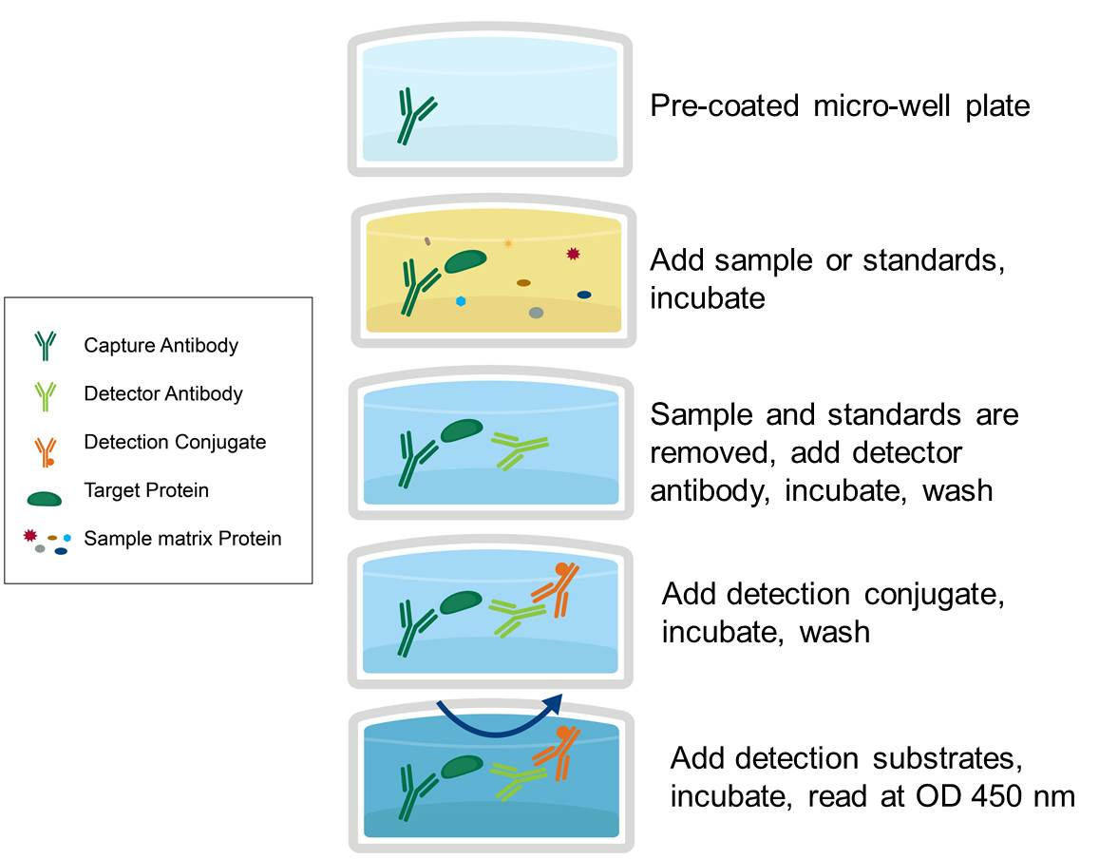
ENZYME LINKED IMMUNOSORBENT ASSAY
REAGENTS
CAPTURE ANTIBODY (PRIMARY AB)
SAMPLE ANTIGEN
BLOCKING AGENT
ANTIBODY-ENZYME CONJUGATE (SECONDARY AB)
CHROMOGENIC SUBSTRATE
THERE ARE OTHER CONFIGURATIONS…
https://www.avivasysbio.com/protocols-procedures/elisa

Slide 7
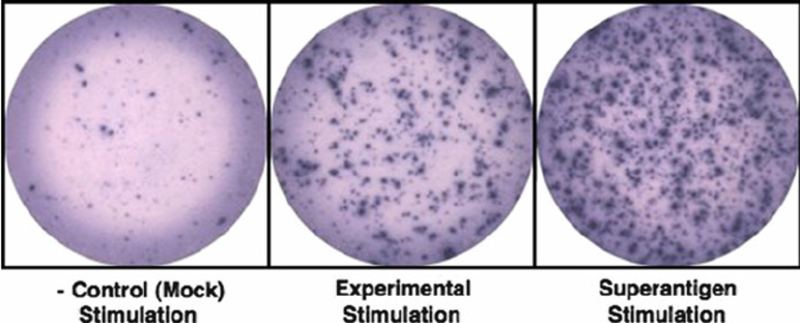
https://www.researchgate.net/figure/Examples-of-ELISPOT-wells-with-SFUs-spot-forming-units-after-color-development_fig1_51751696

Slide 8
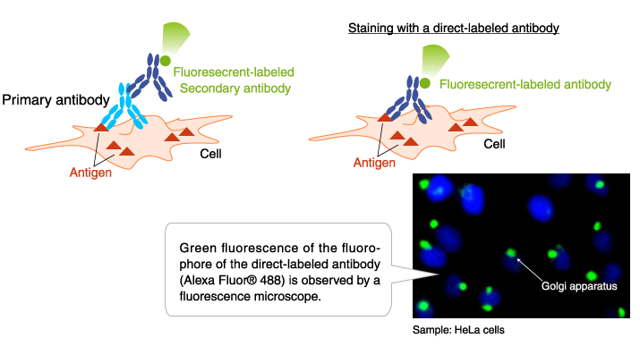
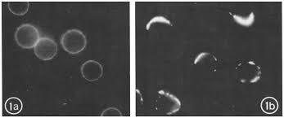
FLUORESCENT MICROSCOPY
Intracellular antigens can be stained by fixing and permeabilizing the plasma membrane
https://www.mblintl.com/products/labeled-antibodies-mbli/
http://citeseerx.ist.psu.edu/viewdoc/download?doi=10.1.1.280.5563&rep=rep1&type=pdf

Slide 9
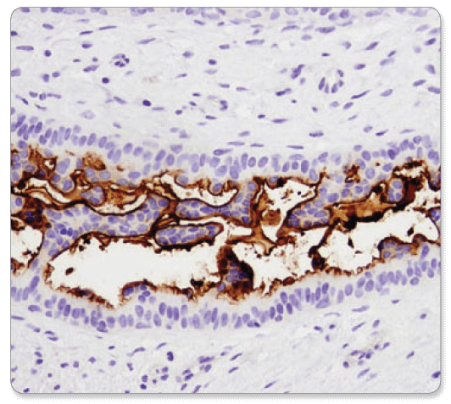
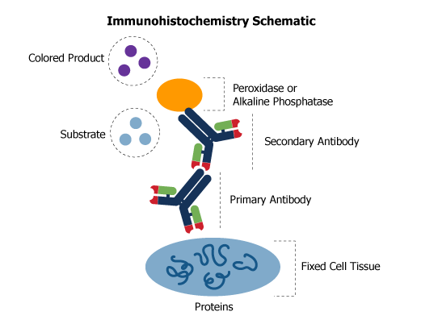
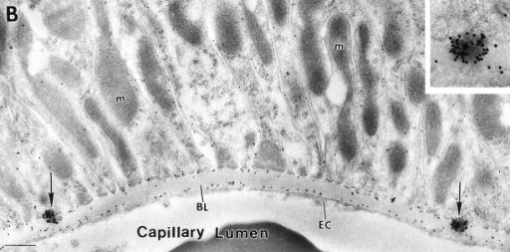
IMMUNOHISTOCHEMISTRY
CD133 (D2V8Q) XP® Rabbit mAb #64326: IHC analysis of paraffin-embedded human breast carcinoma using CD133 (D2V8Q) XP® Rabbit mAb.
IMMUNOELECTRON MICROSCOPY
https://rockland-inc.com/ihc-products.aspx

Slide 10
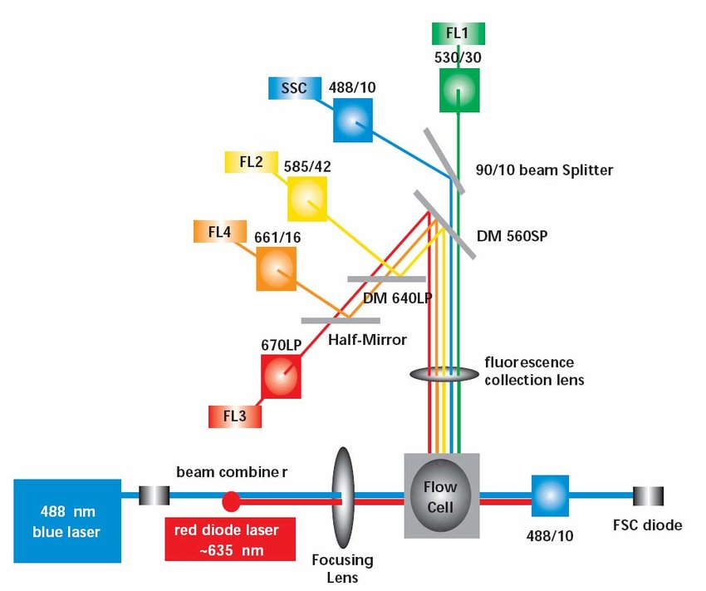
FLOW CYTOMETRY and Fluorescence activated cell sorting (FACS)
https://www.researchgate.net/figure/Schematic-of-the-FACSCalibur-optical-layout-the-488nm-blue-laser-was-used-however-the_fig8_267818602

Slide 11
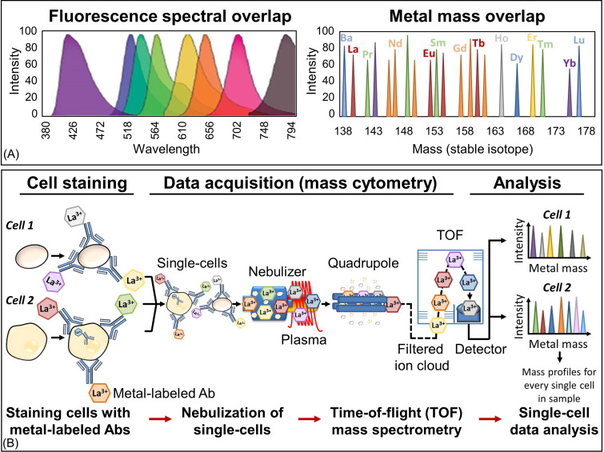
Flow cytometry (fluorescence based signals) vs mass cytometry (heavy metal ion based signals) mark each antibody
https://www.sciencedirect.com/topics/medicine-and-dentistry/mass-cytometry

Slide 12
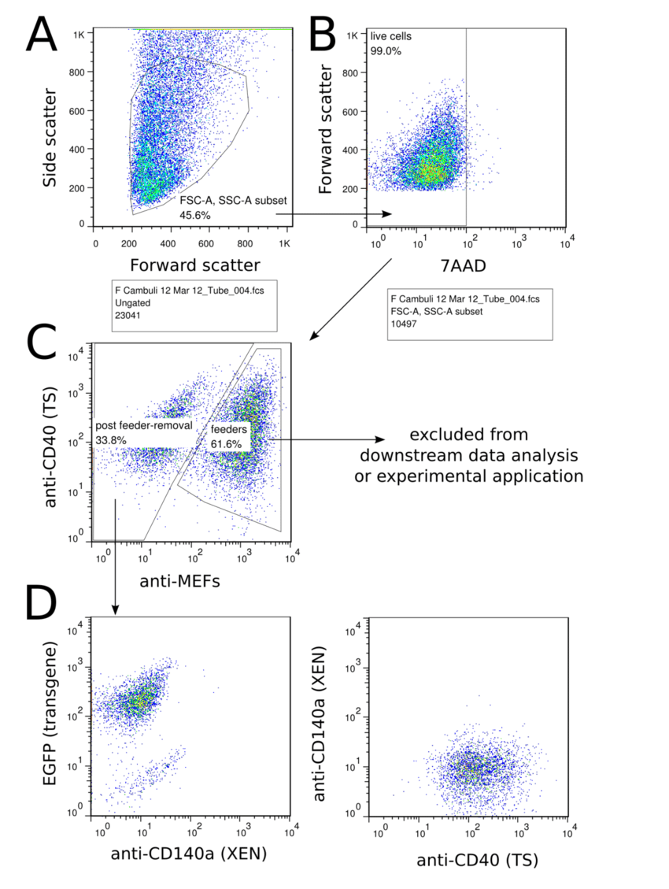
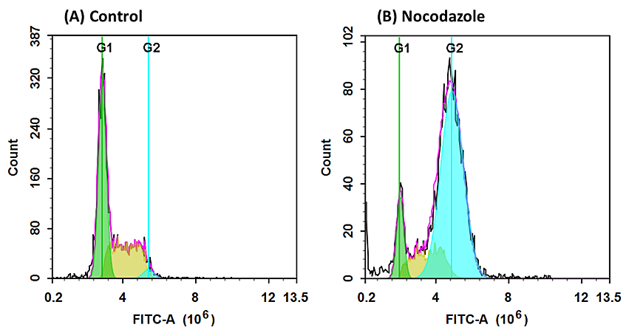
DOT PLOT
DATA FROM FLOW CYTOMETER
HISTOGRAM
Nocodazole synchronizes cell division. Cells treated with nocodazole by arresting at G2- or M-phase.
https://www.aatbio.com/resources/assaywise/2018-7-2/practical-guide-for-live-cell-cycle-analysis-in-flow-cytometry
https://www.researchgate.net/figure/An-example-of-flow-cytometry-data-analysis-FACS-purification-The-strategy-followed-to_fig5_278966289

Slide 13
WESTERN IMMUNOBLOTS

Slide 14
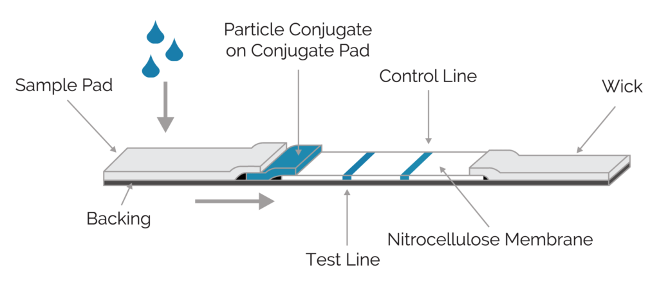
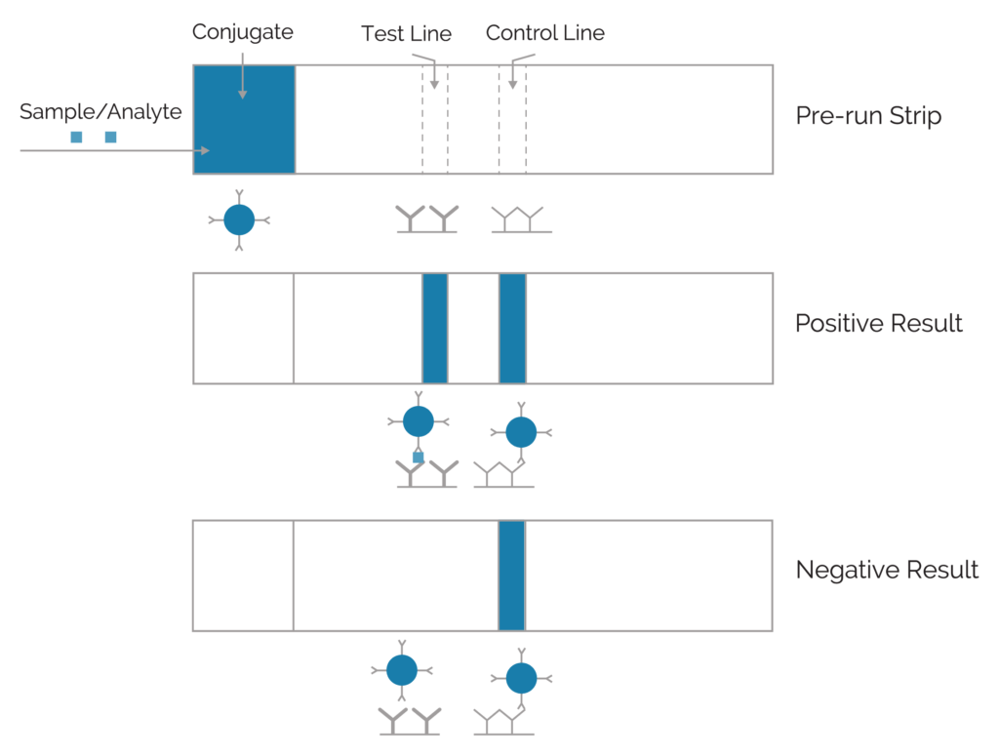
An early pregnancy test is a rapid diagnostic for the pregnancy hormone
The particle is typically colloidal gold or a fluorescent or colored bead coupled to an antigen-specific antibody
https://dcndx.com/lateral-flow-rapid-diagnostic-test/

Slide 15
Now for a change of gears…
How do we get an antibody we need for therapy or for experiments or for diagnosis? Or any other antibody?

Slide 18
How to immortalize a single B cell clone in order to make a single, clonal antibody that can be produced in vitro in limitless supply

Slide 19
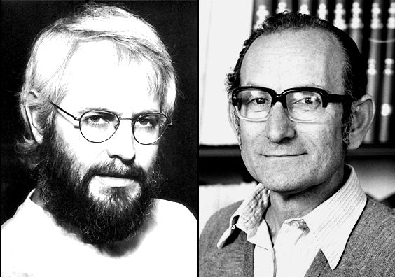
Kohler, G. and Milstein, C., Continuous cultures of fused cells secreting antibody of predefined specificity. Nature, 1975. 256: p. 495-7. http://www.nature.com/nature/journal/v256/n5517/pdf/256495a0.pdf
NOBEL PRIZE IN 1984 FOR THIS DISCOVERY
Global Cancer Monoclonal Antibodies Market was worth USD 41.3 billion in 2019 and is predicted to grow USD 70.6 billion by the end of 2024.
https://www.marketdataforecast.com/market-reports/global-monoclonal-antibodies-market

Slide 20
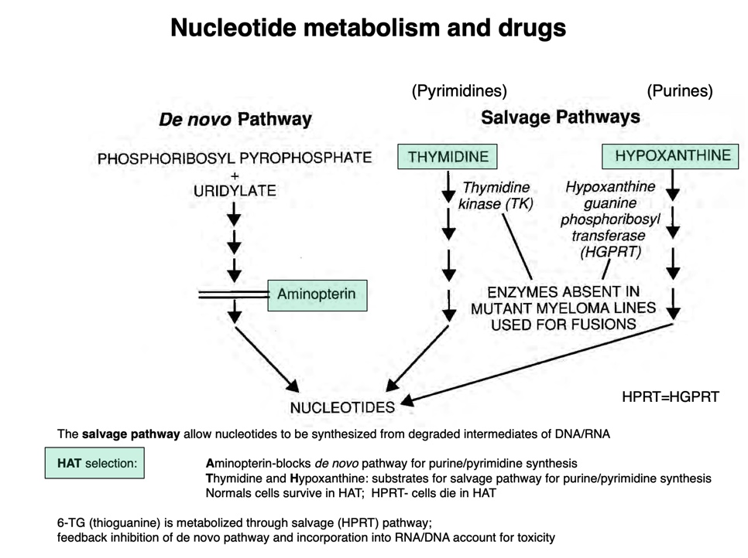
http://www.its.caltech.edu/~bich113/PDFs/Lectures/16_intracellular_signaling.pdf

Slide 22
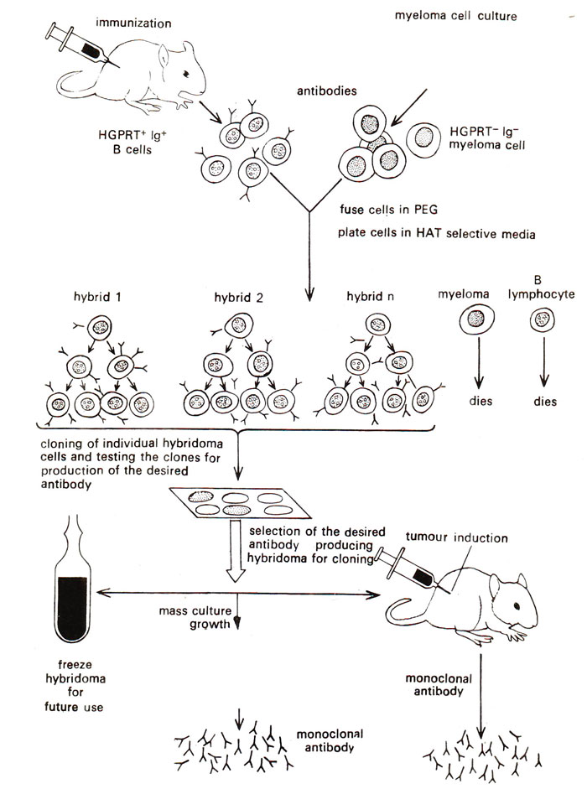

Slide 23
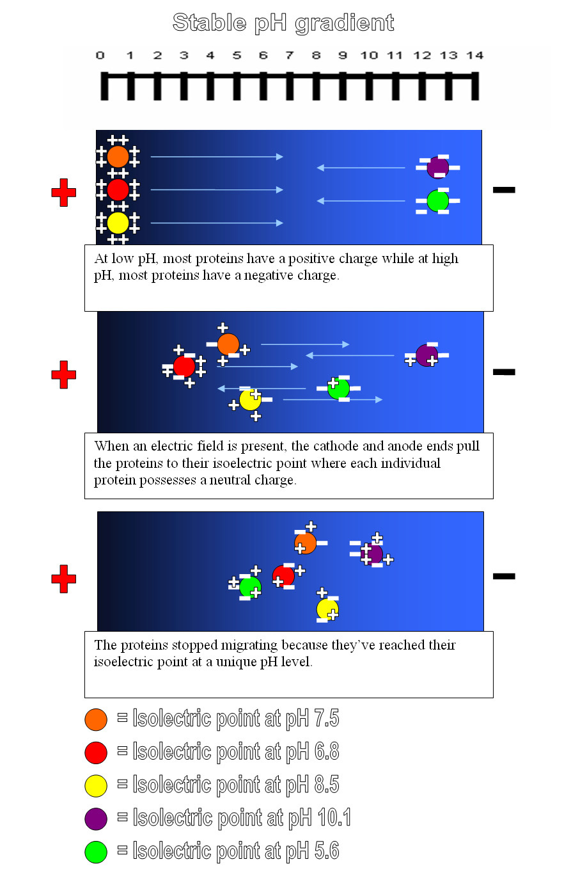
https://en.wikipedia.org/wiki/Isoelectric_focusing

Slide 24
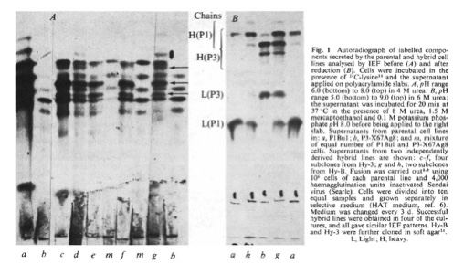

Slide 25
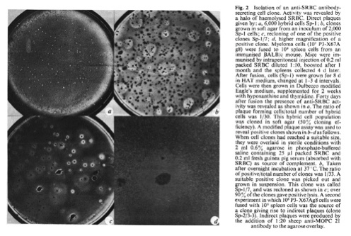

Slide 27
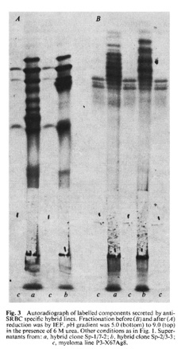

Slide 28
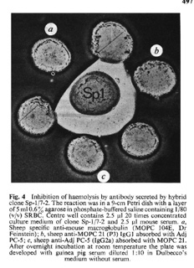

Slide 29
Using mouse antibodies as therapeutics in humans will provoke anti-mouse antibodies. These antibodies will block the therapeutic mouse antibody, and the immune complexes that are formed will filter and accumulate in the kidneys and will activate complement and the membrane attack complex: kidney damage (called “serum sickness” from the days in WWI when horse antibodies were used therapeutically
Beginning in 1914, (about 10 years before the discovery of antibiotics) in the British and French armies, tetanus antiserum (made in horses injected with modified tetanus toxin was routinely given to patients with dirt-contaminated wounds. Serum sickness developed: this is a form of hypersensitivity we will return to later in the semester).
Now we can sequence the Xenogeneic antibody, identify the CDRs, and then clone them into a human Ig H and L chain framework. This can then be expressed in CHO cells, and the product purified for therapeutic use.
Q: why not express in E. coli? (LPS and glycosylation)

Slide 30
On to the quiz…

