Slide 1
MCB 4211
Sept 17 2020
Lecture 6

Slide 2
Lecture: How do antibodies interact with antigens, and how is that measured?
Reading: Primary Literature Reference #1
Reading: Immunobiology textbook (Appendix I: p 748-790) “The immunologist’s toolbox”
A. Antibody-antigen binding: Law of mass action and calculation of affinity constants
1. parameters of binding
2. structural contributions to binding
B. Assays of antibody binding
1. precipitation
2. agglutination
3. radioimmunoassay (RIA)
4. ELISA
5. Fluorescent immunoassay/ Flow cytometry/Fluorescence activated cell sorting (FACS)
6. Western immunoblot analysis
7. immunohistochemistry/immunoelectronmicroscopy
C. Monoclonal antibodies (MAb)
1. how they are made, isolated, and "humanized"
2. functional differences between polyclonal antisera, monospecific sera and MAb

Slide 3
Functional contributions of the different parts of an antibody molecule
Fab and F(ab’)₂ antigen binding
Fc region complement activation
FcR binding
Biological half life in vivo
Antibody stability
Particle opsonization
What are the molecular forces that contribute to antibody: antigen interactions, and how do you measure those forces?

Slide 4
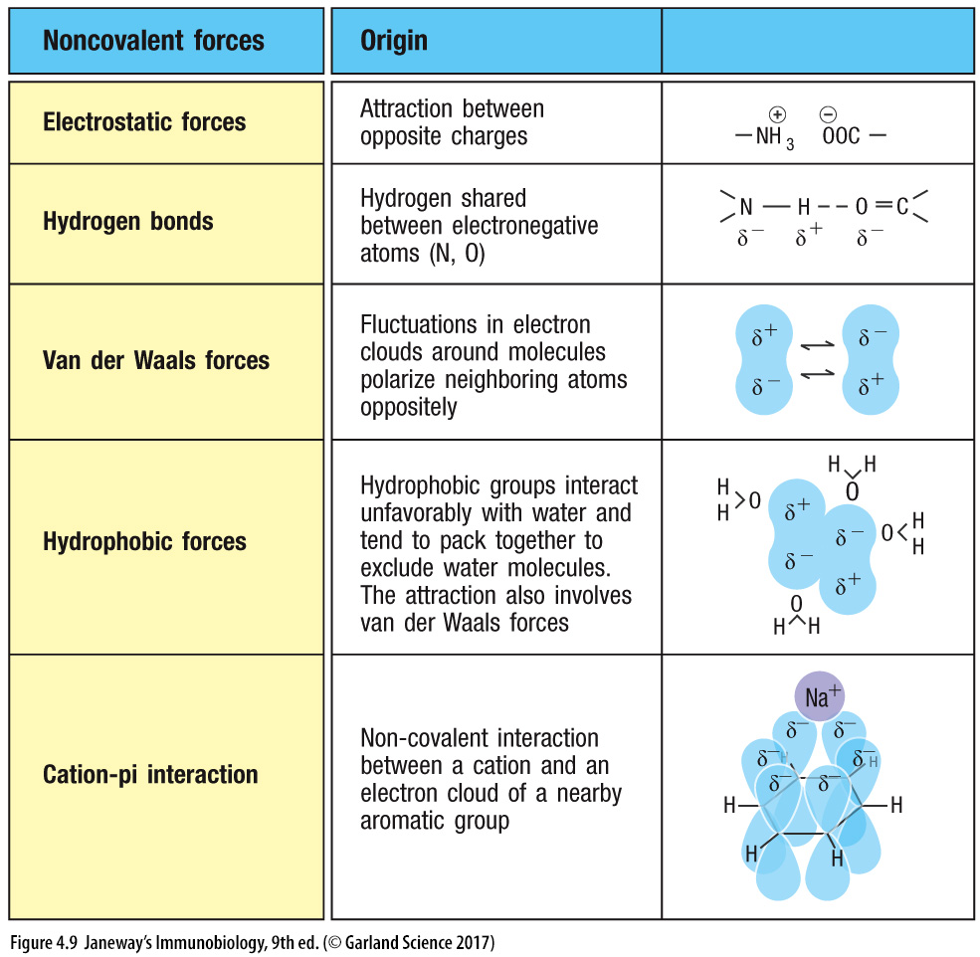
5 forces the contribute to Ab binding to Ag
Individually weak, but many of them combine to make high affinity interactions
Affinity of antibody is measured as affinity constant
[Ab] [Ag]
[AbAg]
[AbAg]
K_{A} is association constant or affinity
K_{A}=
[Ab] [Ag]
This is a calculation for a monovalent Fab. Bivalent antibodies have much higher apparent association with antigen called AVIDITY
equilibrium association constant (Ka) which is simply the reciprocal of equilibrium dissociation constant ( Kd.)

Slide 5
How to measure affinity: Equilibrium dialysis
Other measures: Surface plasmon resonance, ELISA, etc.

Slide 6
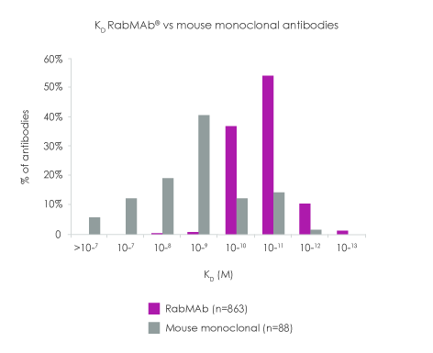
Rabbit monoclonals vs mouse monoclonals
K_{D}​ is the equilibrium dissociation constant, a ratio of k_{off}/k_{on}
K_{D} distribution RabMAb antibodies vs. mouse MAbs: In this comparison the K_{D} values for 88 mouse MAbs were derived from published literature. The individual measurements for each mouse MAb K_{D} value may have been developed using a number of various methods and approaches. The K_{D} measurement values for the 863 RabMAb antibodies were all from the Ol-RD measurement project.
https://www.abcam.com/primary-antibodies/kd-value-a-quantitive-measurement-of-antibody-affinity

Slide 7
Assays of Antibody-Antigen interactions
Precipitation in solution (e.g. Landsteiner experiment)
Precipitation in agarose (e.g. Koehler and Milstein experiment)

Slide 10
AGGLUTINATION

Slide 11
Other assays of Antibody Antigen interaction
Complement dependent antibody mediated cytotoxicity assay

Slide 12
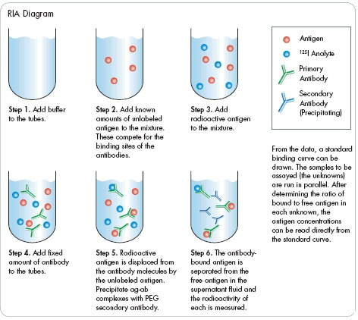
RADIOIMMUNOASSAY (RIA)
https://www.studyread.com/radio-immuno-assay-principle-procedure-ria/

Slide 13
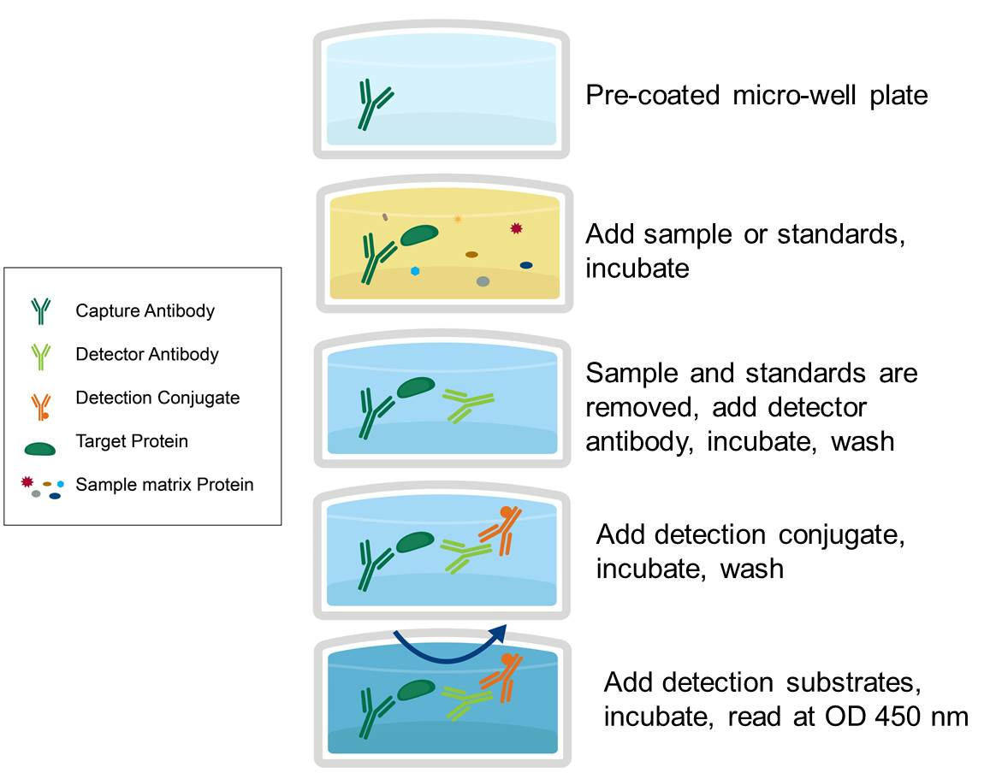
ENZYME LINKED IMMUNOSORBENT ASSAY
REAGENTS
CAPTURE ANTIBODY (PRIMARY AB)
SAMPLE ANTIGEN
BLOCKING AGENT
ANTIBODY-ENZYME CONJUGATE (SECONDARY AB)
CHROMOGENIC SUBSTRATE
THERE ARE OTHER CONFIGURATIONS…
https://www.avivasysbio.com/protocols-procedures/elisa

Slide 14
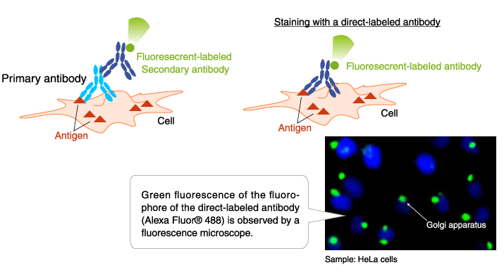
FLUORESCENT MICROSCOPY
https://www.mblintl.com/products/labeled-antibodies-mbli/

Slide 15
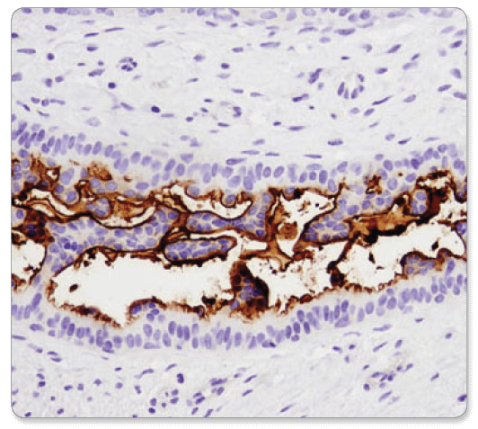
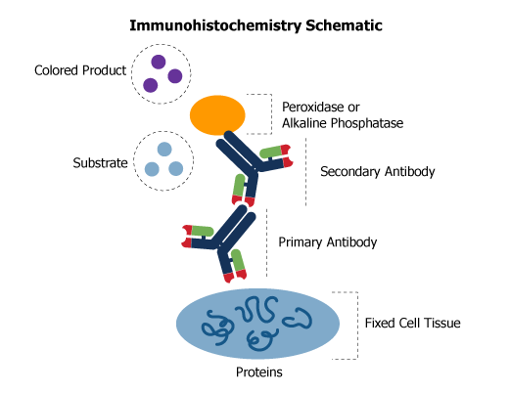
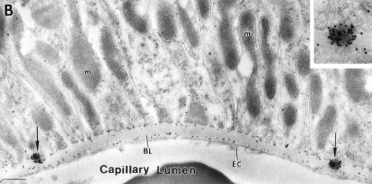
IMMUNOHISTOCHEMISTRY
CD133 (D2V8Q) XP® Rabbit mAb #64326: IHC analysis of paraffin-embedded human breast carcinoma using CD133 (D2V8Q) XP® Rabbit mAb.
IMMUNOELECTRON MICROSCOPY
https://rockland-inc.com/ihc-products.aspx

Slide 16
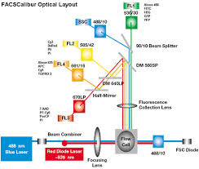
FLOW CYTOMETRY

Slide 17
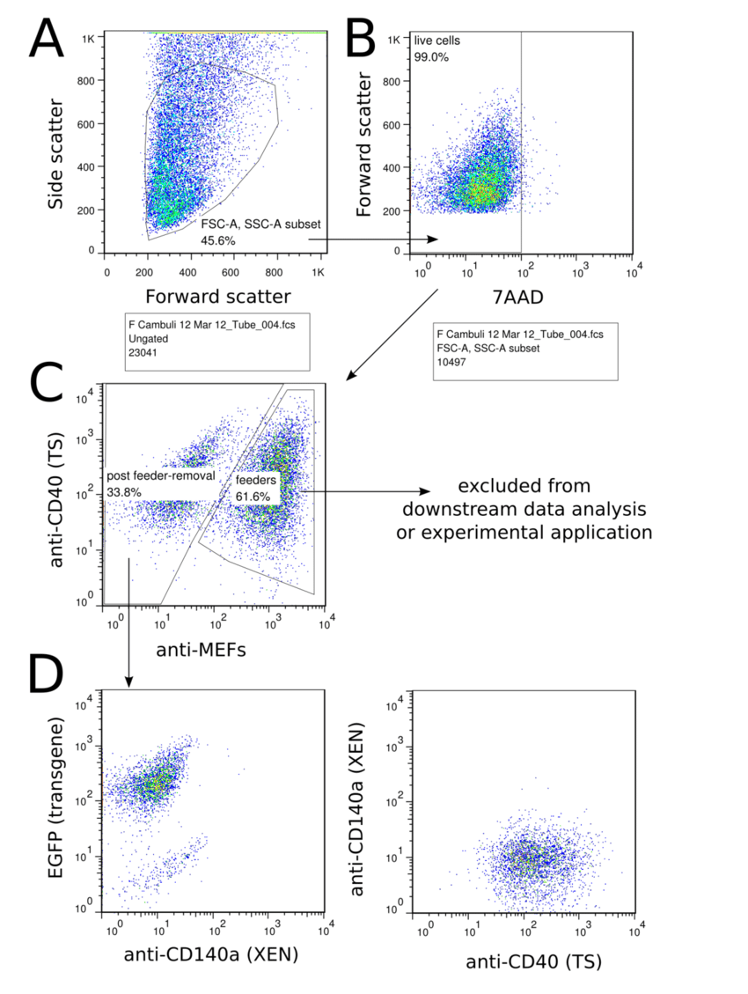
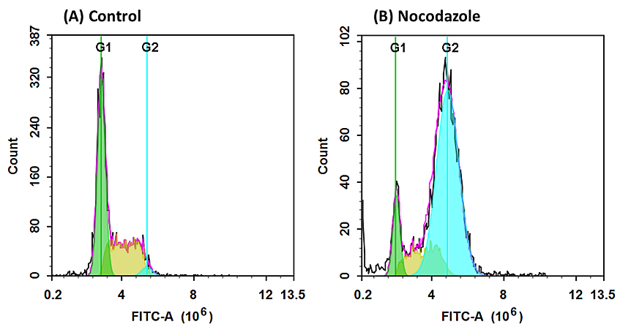
DOT PLOT
DATA FROM FLOW CYTOMETER
HISTOGRAM
Nocodazole synchronizes cell division. Cells treated with nocodazole by arresting at G2- or M-phase.
https://www.aatbio.com/resources/assaywise/2018-7-2/practical-guide-for-live-cell-cycle-analysis-in-flow-cytometry
https://www.researchgate.net/figure/An-example-of-flow-cytometry-data-analysis-FACS-purification-The-strategy-followed-to_fig5_278966289

Slide 18
WESTERN IMMUNOBLOTS

Slide 22
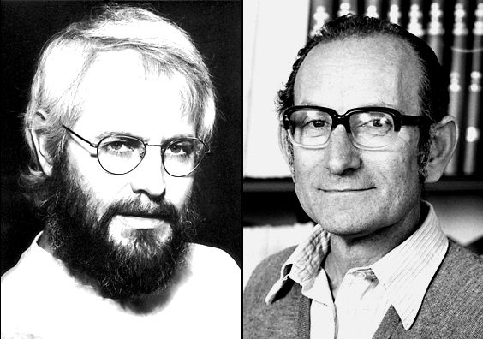
Kohler, G. and Milstein, C., Continuous cultures of fused cells secreting antibody of predefined specificity. Nature, 1975. 256: p. 495-7. http://www.nature.com/nature/journal/v256/n5517/pdf/256495a0.pdf
NOBEL PRIZE IN 1984 FOR THIS DISCOVERY
Global Cancer Monoclonal Antibodies Market was worth USD 41.3 billion in 2019 and is predicted to grow USD 70.6 billion by the end of 2024.
https://www.marketdataforecast.com/market-reports/global-monoclonal-antibodies-market

Slide 23
NEXT
DNA SYNTHESIS PATHWAYS
HOW TO MAKE MAB
HOW TO TEST MABS
ISSUES WITH MOUSE MABS WHEN USED THERAPEUTICALLY/SERUM SICKNESS
HOW TO RESOLVE THOSE ISSUES WITH RECOMBINANT CHIMERIC HUMANIZED ANTIBODIES
QUIZ 9/22 15 MINUTES 10 MULTIPLE CHOICE QUESTIONS CLOSED BOOK

