Slide 1
Coronavirus basics, 2020

Slide 2
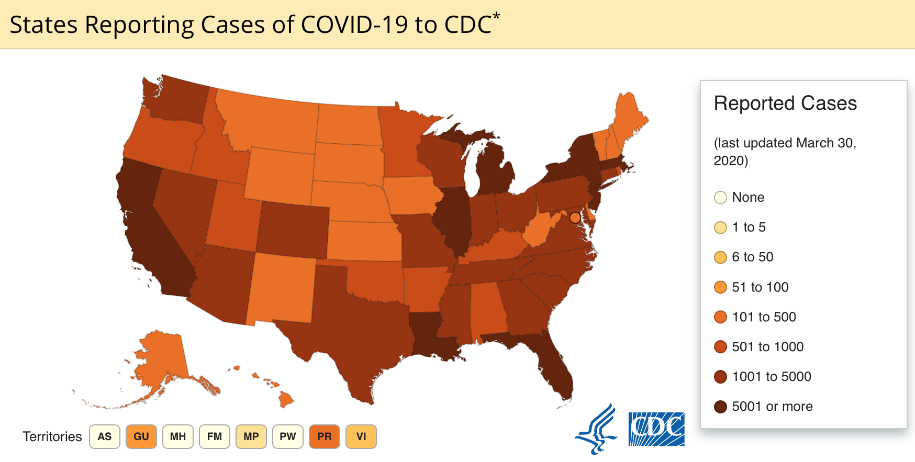

Slide 3
General structure
Transmission electron microscope image shows SARS-CoV-2, the virus that causes COVID-19, isolated from a patient in the U.S. Virus particles are emerging from the surface of cells cultured in the lab. The spikes on the outer edge of the virus particles give coronaviruses their name, crown-like.NIAID-RML
https://www.nih.gov/news-events/nih-research-matters/novel-coronavirus-structure-reveals-targets-vaccines-treatments

Slide 4
General info ( from CDC website)
Virus name: SARS-CoV-2
Disease name Coronavirus disease 2019 (abbrev COVID-19)
Coronaviruses are a large family of viruses found in humans and many animals (ex camels, cattle, cats, bats)
Rare animal virus spread to humans; MERS-CoV, SARS-CoV
SARS-CoV-2=betacoronavirus like MERS-CoV, SARS-CoV; all 3 originate in bats
Sequencing suggests US patient virus ~ Chinese posted sequence, suggesting single recent emergence

Slide 5
Phylogenetic comparisions of coronaviruses based on complete genomes.
The MERS-CoV genome structure and virion. MERS-CoV, Middle East respiratory syndrome coronavirus.
http://jtd.amegroups.com/article/view/20125/html

Slide 6
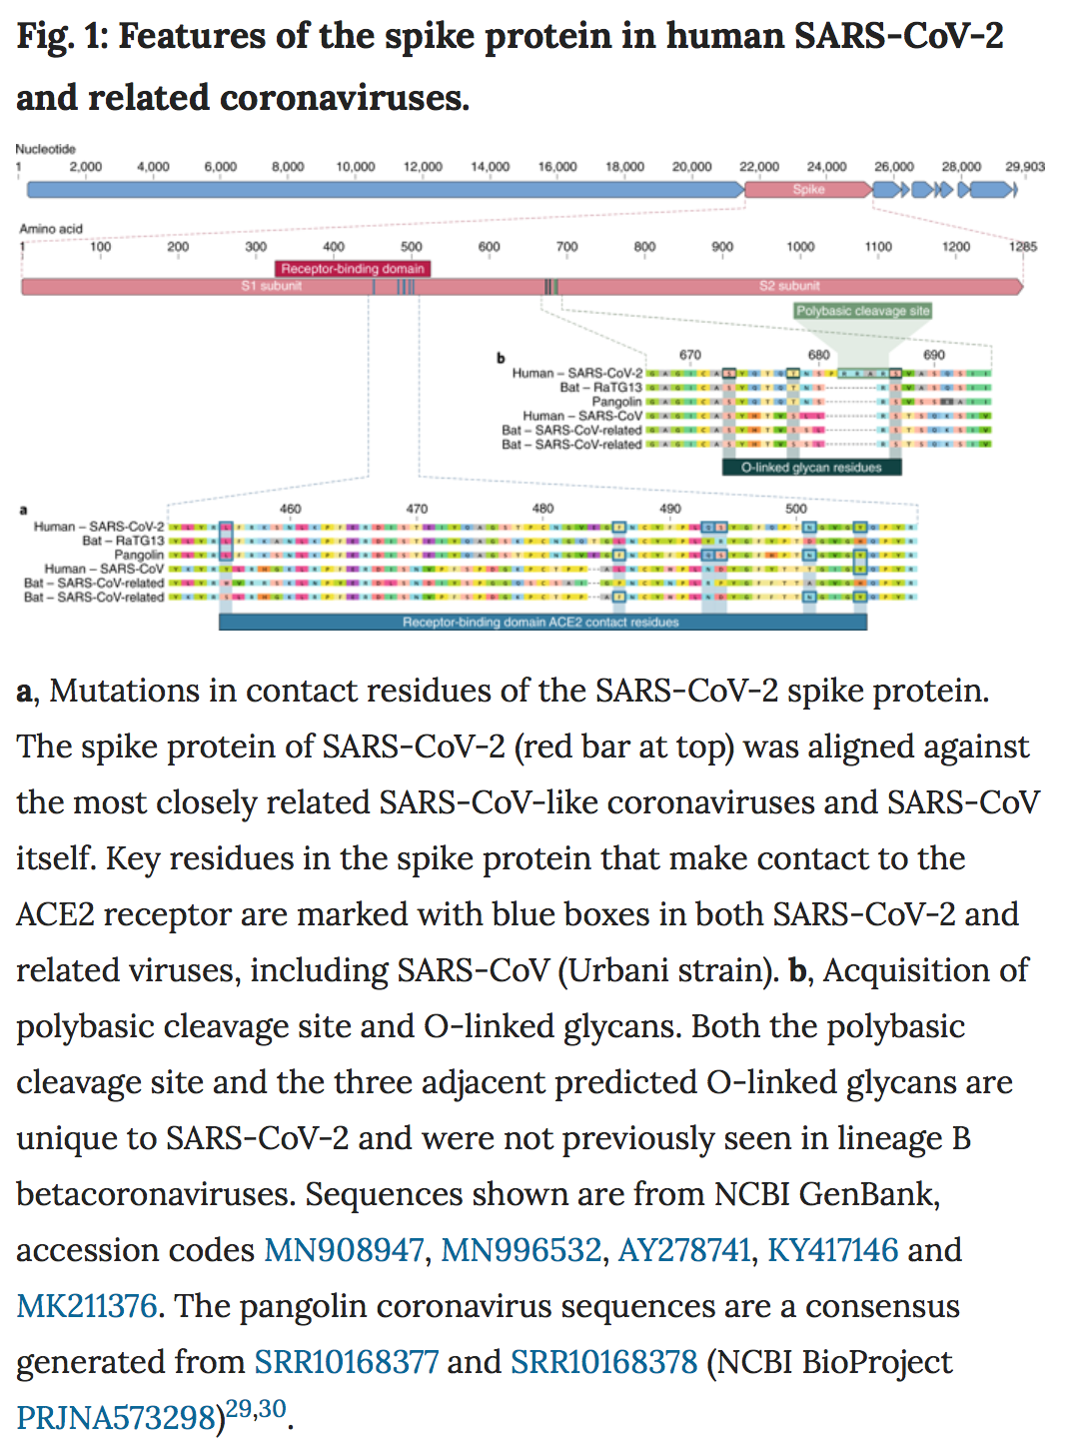
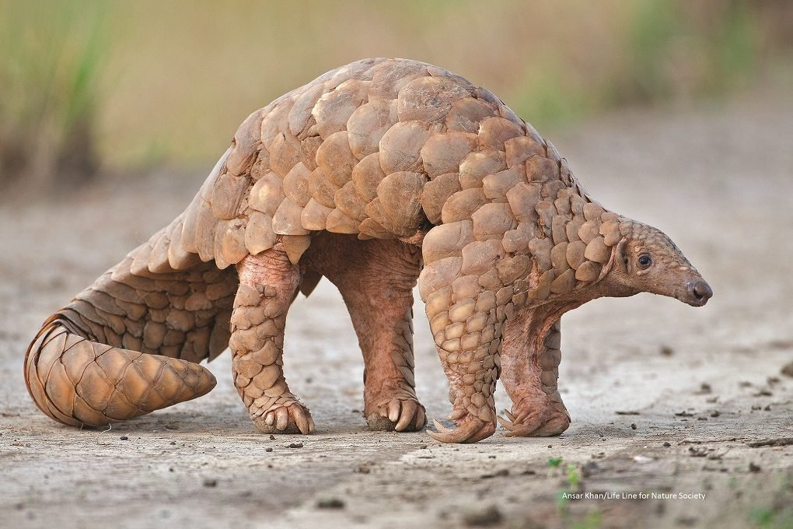
“In the first scenario, as the new coronavirus evolved in its natural hosts, possibly bats or pangolins, its spike proteins mutated to bind to molecules similar in structure to the human ACE2 protein, thereby enabling it to infect human cells. This scenario seems to fit other recent outbreaks of coronavirus-caused disease in humans, such as SARS, which arose from cat-like civets; and Middle East respiratory syndrome (MERS), which arose from camels.
The second scenario is that the new coronavirus crossed from animals into humans before it became capable of causing human disease. Then, as a result of gradual evolutionary changes over years or perhaps decades, the virus eventually gained the ability to spread from human-to-human and cause serious, often life-threatening disease.”
The proximal origin of SARS-CoV-2 . Andersen KG, Rambaut A, Lipkin WI, Holmes EC, Garry RF. Nat Med, 17 March 2020.

Slide 7
Resources
Complete genomic sequence https://www.ncbi.nlm.nih.gov/nuccore/MN908947
Other sequences from other isolates https://www.ncbi.nlm.nih.gov/genbank/sars-cov-2-seqs/

Slide 8
Recombinant Spike protein Cryo-EM structure
SARS-CoV-2 spike is 10 to 20 times more likely to bind ACE2 on human cells than the spike from the SARS virus from 2002
Atomic-level structure of the SARS-CoV-2 spike protein. The receptor binding domain, the part of the spike that binds to the host cell, is colored green. UT Austin, McLellan Lab
Published Feb 19,2020 Science

Slide 9
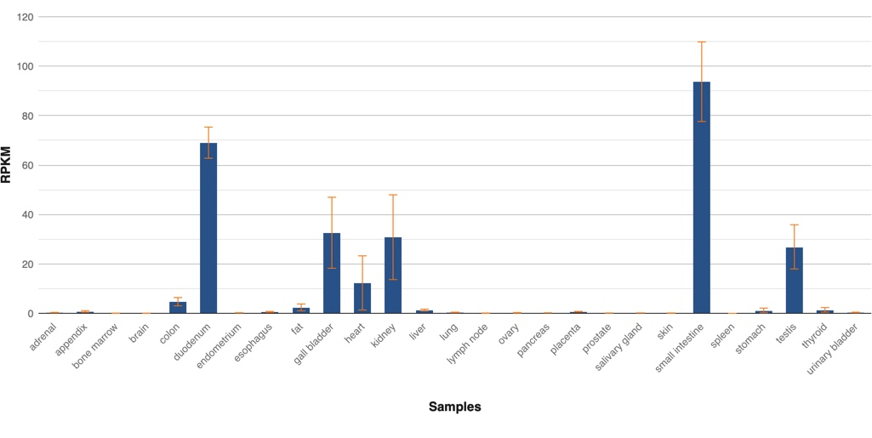
The Spike protein putative receptor, ACE2
SARS-CoV-2 spike was 10 to 20 times more likely to bind ACE2 on human cells than the spike from the SARS virus from 2002
The protein encoded by this gene belongs to the angiotensin-converting enzyme family of dipeptidyl carboxydipeptidases
considerable homology to human angiotensin 1 converting enzyme.
organ- and cell-specific expression of this gene suggests that it may play a role in the regulation of cardiovascular and renal function, as well as fertility.
functional receptor for the spike glycoprotein of the human coronavirus HCoV-NL63 and the human severe acute respiratory syndrome coronaviruses, SARS-CoV and SARS-CoV-2 (COVID-19 virus). [provided by RefSeq, Mar 2020]
Expression of ACE2
“ACE2 virus receptor expression is concentrated in a small population of type II alveolar cells (AT2). Surprisingly, we found that this population of ACE2-expressing AT2 also highly expressed many other genes that positively regulating viral reproduction and transmission. A comparison between eight individual samples demonstrated that the Asian male one has an extremely large number of ACE2-expressing cells in the lung. “*
https://www.ncbi.nlm.nih.gov/gene/59272
*https://www.biorxiv.org/content/10.1101/2020.01.26.919985v1.full

Slide 10
Cross reactivity; epitope sharing?
Despite similarities in sequence and structure between the spikes of the two viruses, three different antibodies against the 2002 SARS virus could not successfully bind to the SARS-CoV-2 spike protein. This suggests that potential vaccine and antibody-based treatment strategies will need to be unique to the new virus.

Slide 11
MERS-CoV
As of 2018, there was no successful vaccine for MERS-CoV
Antiviral therapies for MERS-CoV
Neutralizing monoclonal antibodies bind to MERS-CoV spike protein and prevent virus-entry and following membrane fusion, therefore inhibit viral replication and reduce clinical diseases in animal models and humans (86).
Neutralizing human monoclonal antibody (mAb) can be used for prophylactic and post-exposure treatments. Several potent mAbs have been developed from MERS infected patient (96), by humanizing mouse mAb against MERS RBD (97) or by screening human antibody phage library (82). All of these mAbs targeted RBD region of spike protein (98).
To avoid viral escape mutants, combination of at least two monoclonal antibodies targeting different regions of spike protein have been proven to be more effective (86).
antiviral drugs
peptide fusion inhibitor targeting heptad-repeat region (HR) of S2 (99
small molecular entry inhibitor targeting S (100),
IFN-β, IFN-γ and ribavirin (101).
GS-5734, small-molecule monophosphoramidate, prodrug of an adenosine analog which targeted RdRp, had been found to inhibit MERS-CoV and SARS-CoV replication in multiple in vitro systems (102).
http://jtd.amegroups.com/article/view/20125/html

Slide 12
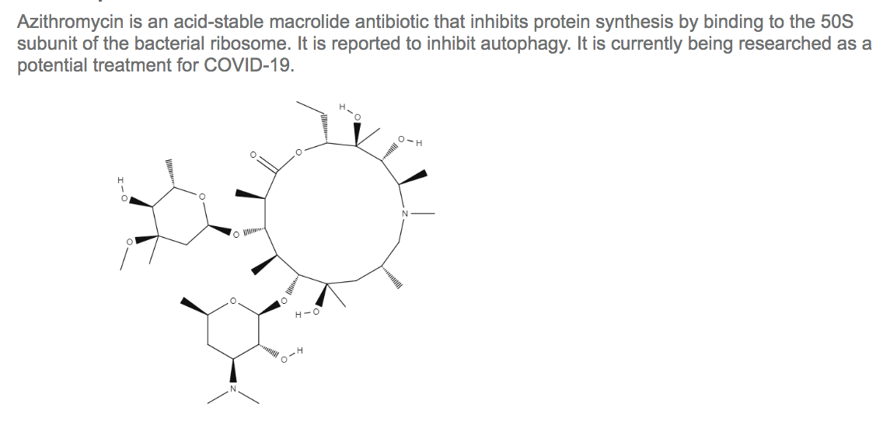
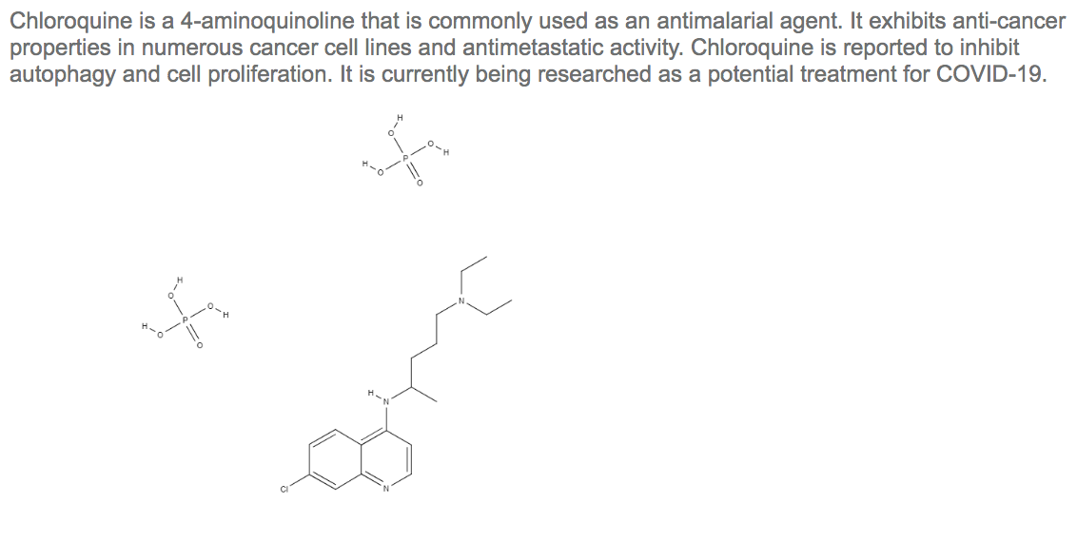

Slide 13
Recent findings of COVID-19 studies
Hydroxychloroquine and azithromycin as a treatment of COVID‐19: results of an open‐label non‐randomized clinical trial
Guatret et al., (2020) International Journal of Antimicrobial Agents – In Press 17 March 2020 – DOI 10.1016/j.ijantimicag.2020.105949
--------------
Reduction and Functional Exhaustion of T Cells in Patients with Coronavirus Disease 2019 (COVID-19)
Diao et al., (2020)BMJ Yale, doi: https://doi.org/10.1101/2020.02.18.20024364

Slide 14
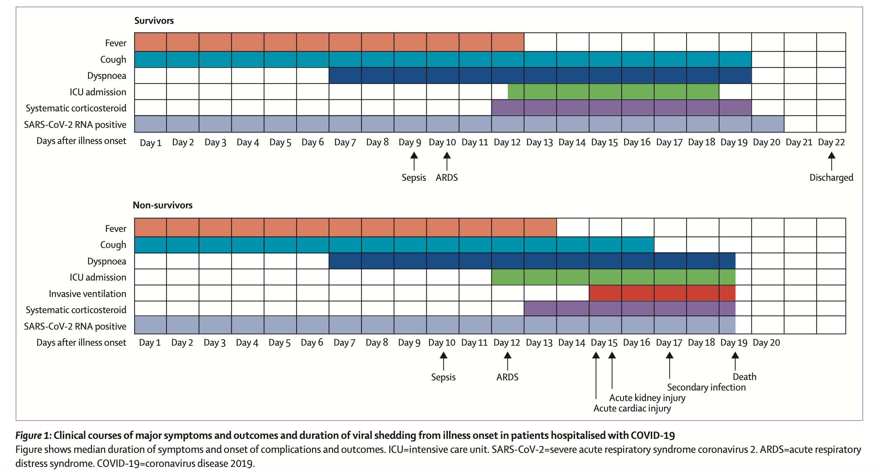
Clinical course and risk factors for mortality of adult inpatients with COVID-19 Zhou et al., 2020 https://doi.org/10.1016/ S0140-6736(20)30566-3

Slide 15
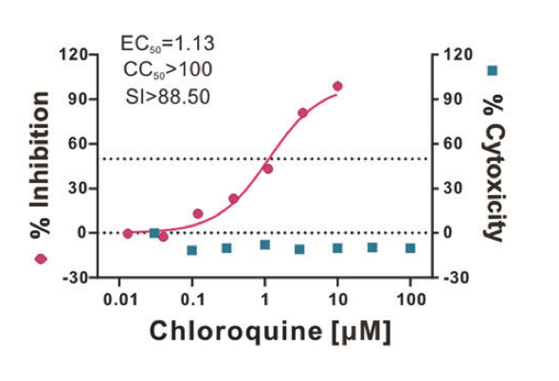
Potential Treatments for COVID-19
Remdesivir and chloroquine effectively inhibit the recently emerged novel coronavirus (2019-nCoV) in vitro
Wang et al., 2020, https://doi.org/10.1038/s41422-020-0282-0
Azithromycin alters macrophage phenotype
Murphy et al., 2008 https://doi.org/10.1093/jac/dkn007

Slide 16
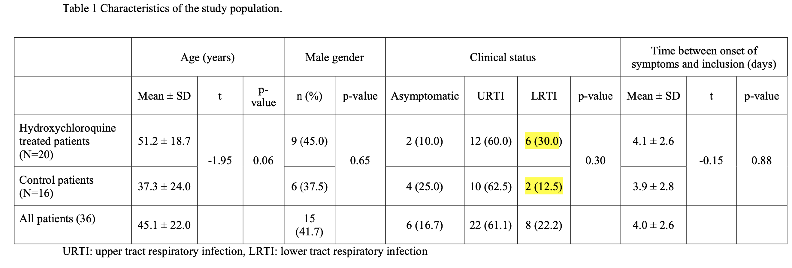
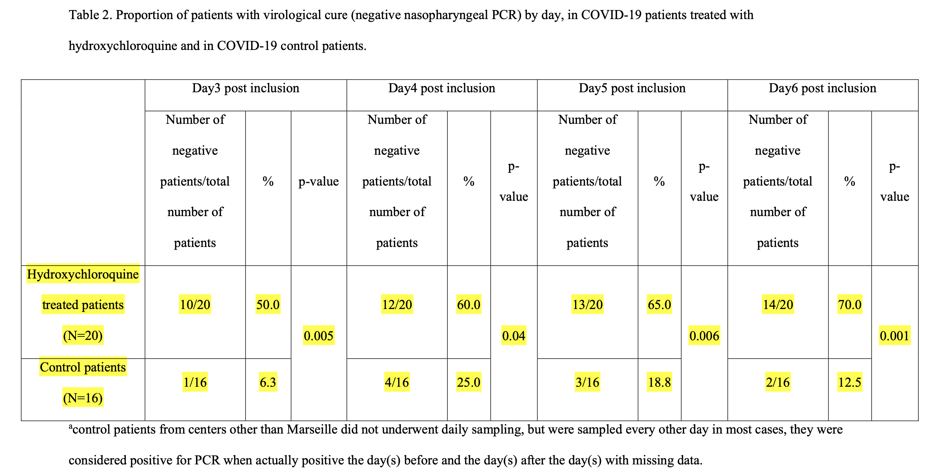
Hydroxychloroquine and azithromycin as a treatment of COVID‐19: results of an open‐label non‐randomized clinical trial

Slide 17
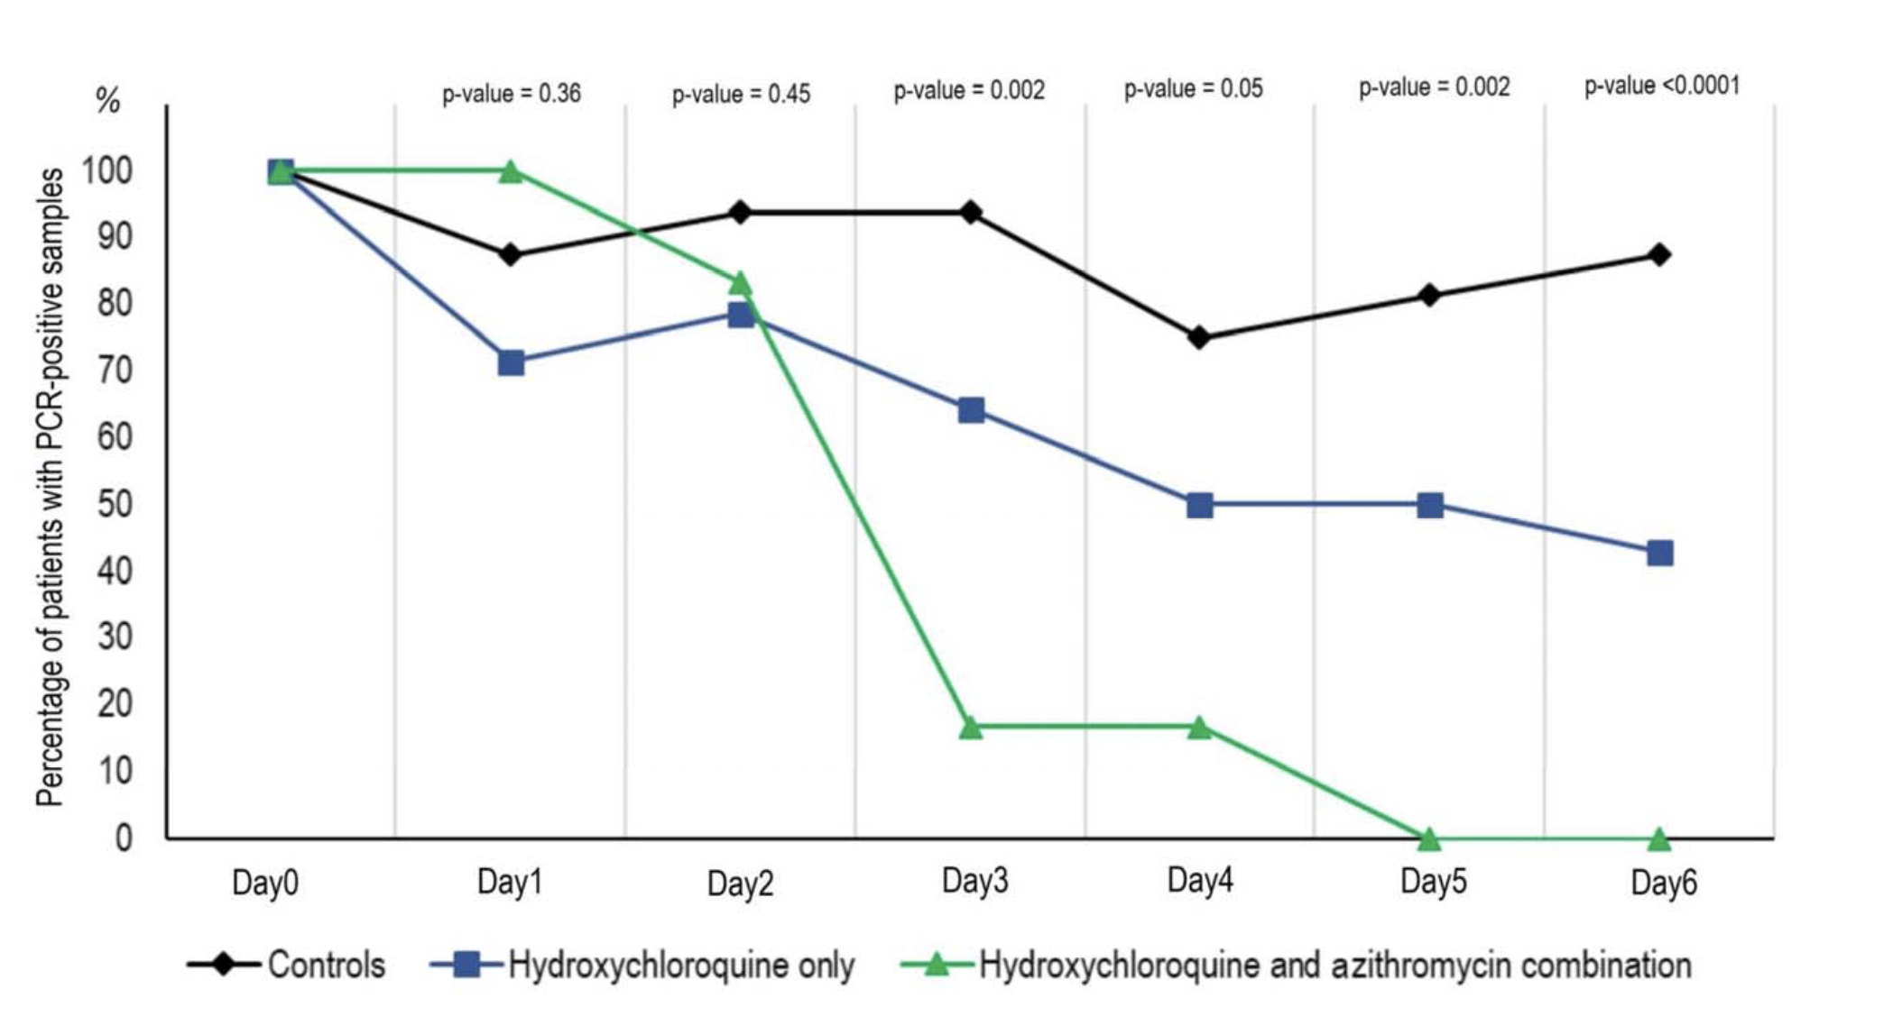
Combination Hydroxychloroquine & Azithromycin
Figure 2. Percentage of patients with PCR-positive nasopharyngeal samples from inclusion to day6 post-inclusion in COVID-19 patients treated with hydroxychloroquine only, in COVID-19 patients treated with hydroxychloroquine and azithromycin combination, and in COVID-19 control patients.

Slide 18
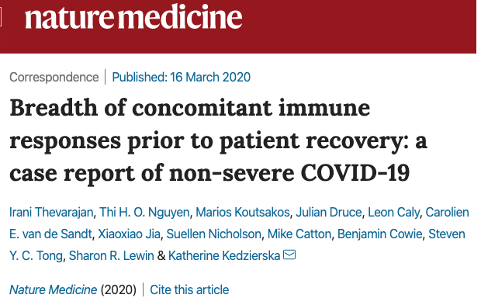
47-year-old woman from Wuhan, Hubei province, China
Traveled from Wuhan to Australia 11 d before presentation
No contact with the Huanan seafood market or with known COVID-19 cases
Otherwise healthy and was a non-smoker taking no medications
Mild-moderate COVID-19
Increase in
Antibody-secreting cells
Follicular helper T cells
Activated CD4+ and CD8+ T cells
IgM and IgG antibodies detected before symptomatic recovery
Immunological changes at least 7d following full resolution of symptoms
Contrast to severe avian H7N9 disease, which had elevated cytokines IL-6, IL-8, IL-10, MIP-1β and IFN-γ, minimal pro-inflammatory cytokines and chemokines were found in this patient with COVID-19, even while she was symptomatic at days 7–9
Multi-factorial immune responses can be elicited to the newly emerged virus SARS-CoV-2 and, similar to the avian H7N9 disease, early adaptive immune responses might correlate with better clinical outcomes

Slide 20
Notes:
Inpatient data of 522 patients with laboratory-confirmed COVID-19, admitted into two hospitals in Wuhan from December 2019 to January 2020, and 40 healthy controls, who came to the hospitals for routine physical examination
COVID-19 5 days to 97 years
qRT-PCR of throat swab samples
43 ICU- required high-flow nasal cannula or higher=level oxygen support measure to correct hypoxaemia (arterial oxygen tension PaO2/inspiratory oxygen fraction FIO2 <300mmHg or arterial oxygen saturation of <93%)
Prodromal period- beginning of signs and symptoms
Illness period- most obvious and severe with positive lab findings and chest images
ICU period
Decline period-improving
Healthy 2-62

Slide 21
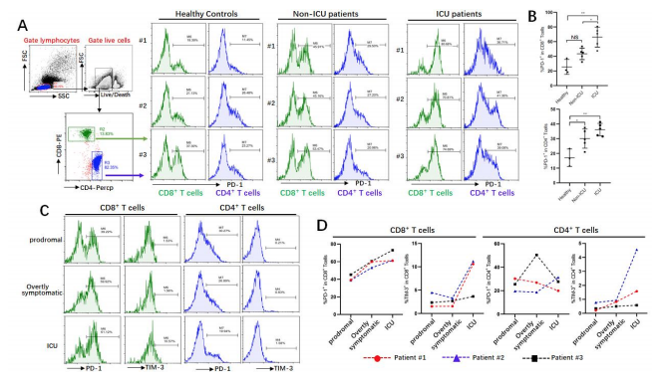
Figure 3 Exhaustion of T cells in COVID-19 patients. A,B. PD-1 expressions on T cells in different groups; C, D. Dynamic profile of PD-1 and TIM-3 expressions on T cells in 3 patients. NS: not significant, *p<0.01.

Slide 22
Airway memory CD4⁺ T cells mediate protective immunity against emerging respiratory coronaviruses.
http://jtd.amegroups.com/article/view/20125/html

Slide 23
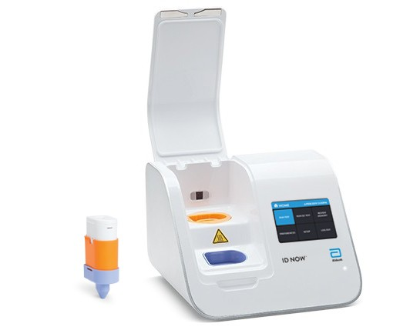
Isothermal amplification of a single diagnostically relevant sequence producing a fluorescent signal when amplified
positive results in 5 minutes
negative results in 13.
The ID NOW™ COVID-19 assay is now available for use on the ID NOW platform under U.S. Food and Drug Administration Emergency Use Authorization (EUA). The ID NOW™ COVID-19 rapid test delivers high-quality molecular positive results in as little as 5 minutes, targeting the coronavirus (COVID-19) RdRp Gene (RNA dependent RNA polymerase)

Slide 24
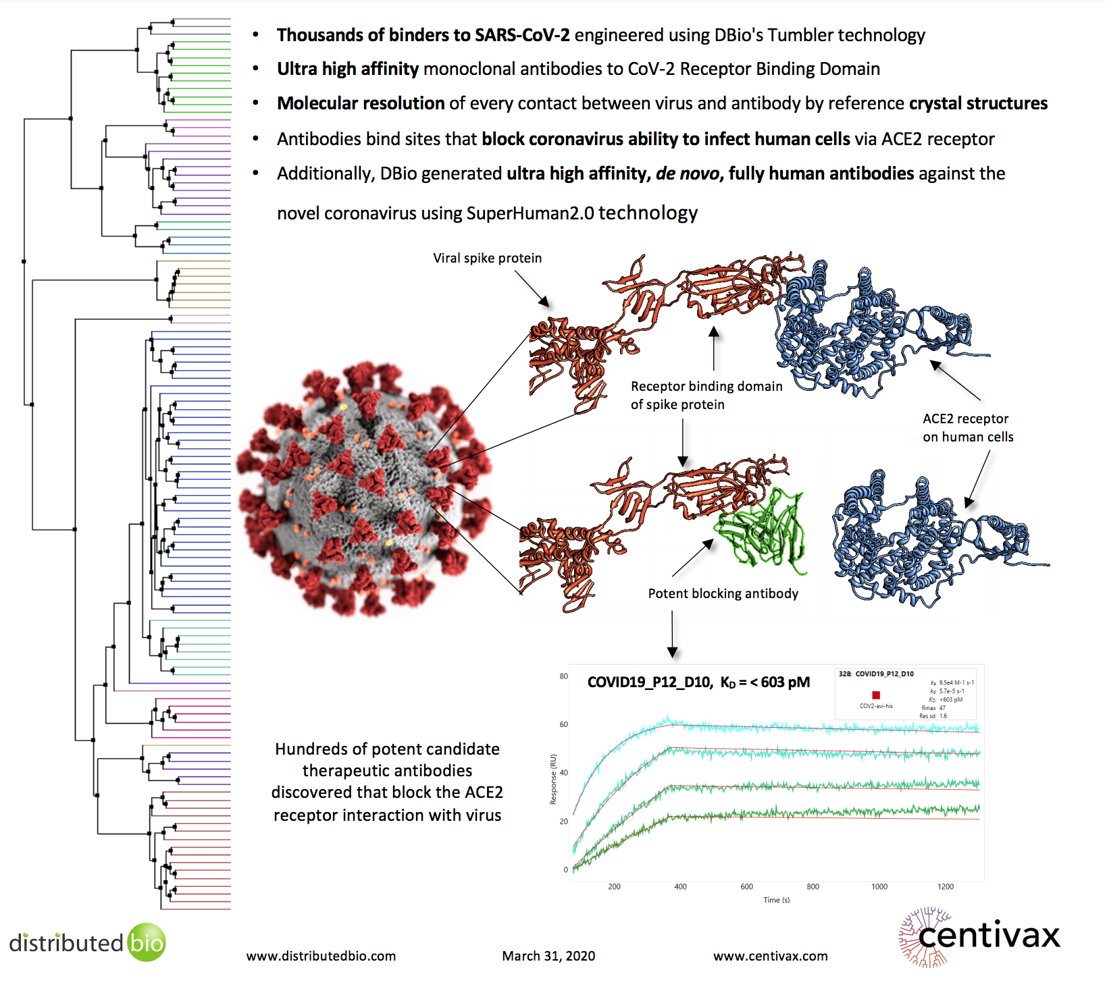
Adoptive antibody therapeutics
engineered a panel of anti-SARS antibodies to make them recognize and block the novel coronavirus
panel of ultra-high affinity therapeutic antibodies to neutralize SARS-CoV-2
Used naturally occurring VDJ and VJ regions from human genome; made from 5 anti SARS
Distributedbio.com

