Slide 1
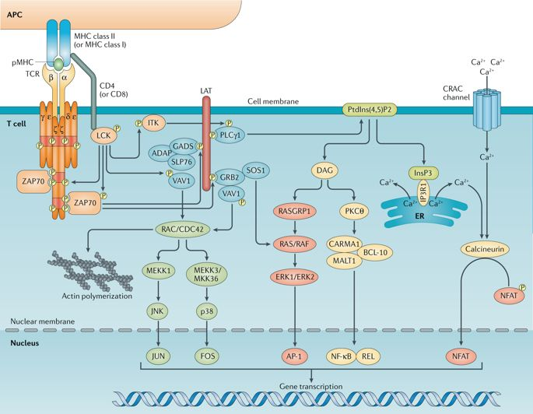
Nature Reviews Immunology volume 18, pages485–497 (2018)

