Slide 1
Grantsmanship
$
$
$
$
$
$
$
$
$
$
$
$
$
$
$
$
$
$
$
$
$
$
$
$
$
$
$
$
$
$
$
$
$
$
$
$
$
$
$
$
$
$
$
$
$
$
$
$
$
$
$
$
$
$
$
$
$
$
$
$
$
$
$
$
$
$
$
$
$
$
$
$
$
$
$
$
$

Slide 2
Theory vs Hypothesis
A theory predicts events in general terms, while a hypothesis makes a specific prediction about a specified set of circumstances.
A theory has been extensively tested and is generally accepted, while a hypothesis is a speculative guess that has yet to be tested.
http://psychology.about.com/od/researchmethods/ss/expdesintro_2.htm

Slide 3
“MAGIC” an acronym describing the goals of persuasive research.
Magnitude, or the degree of empirical support for the claim made by the data
Articulation, or the level of detail provided by the results
Generality, or the degree to which the results apply to a broadly defined population
Interestingness, which involves both the importance of the issue being investigated and the data’s ability to change existing beliefs
Credibility, which arises out of sound theory and method.
--From: Statistics as Principled Argument, Robert Abelson

Slide 4
1 page describing your “Specific Aims”
This is how you will address your hypothesis or provide a solution to a critical need
Your goal is to focus the reviewers attention on main points of your project in ~1 page
This page should summarize:
Introduction –Definition of Problem/Critical Need
Proposed Solution -Your Objectives & Rationale
Specific Aims -Steps to addressing critical need
Significance –Novelty, Expectations & Impact
Most reviewers will have decided on fundability by the end of the Specific Aims, and will then look in the body of the text for reasons to support their conclusions.

Slide 5
First sentences
Indicate what the grant is about
Connect grant goals to those of the funding agency
You should be familiar with RFA’s and RFPs as well as with the NIH “Roadmap”
http://commonfund.nih.gov/index.aspx
Focus of grant: To identify lymph node metastases in patients with resectable lung cancer
Option A: Lung cancer is the leading cause of cancer deaths among both men and women in the US.
Option B: Failure to identify regional lymph node metastases in the 40,000 US patients/yr with surgically resected lung cancer is associated with a 3-fold increase in recurrence and decreased overall survival.

Slide 6
Introduction
Present the critical facts that a reviewer must know to appreciate the proposal
Demonstrate that grant addresses a critical problem that MUST be solved
Explain why the grant is important to the mission of the funding agency

Slide 7
What are your objectives?
Your experiments must have well-defined end-points and should follow a specific plan for accomplishing objectives
If you test a hypothesis –you must predict the outcomes both if your experiment is correct and if it is not (“anticipated outcomes, potential pitfalls, and alternative approaches”)
Have realistic objectives
“Cure cancer”vs. “identify the role played by myeloid derived suppressor cells in the progression of leukemia”

Slide 8
Rationale
What is importance of this project?
How will funding this project produce change in society/medicine/human health, etc?
How does this relate to the institute mission?

Slide 9
Investigators
How does your expertise make you the best qualified to do this research?
This is an important consideration when
Identifying projects
Selecting collaborators to supplement your expertise
Choosing training paths (e.g. will your postdoc mentor let you take some of your project with you when you go on to an independent position)

Slide 10
Specific Aims
2-5 clearly stated goals that encapsulate the main point of the activity (do not overpromise)
Create a logical flow from one aim to the next
Each aim can have several interrelated experimental activities
Try to avoid describing the experimental approach
Use active verbs and avoid vague aims

Slide 11
Significance
Statement of innovation/novelty
Novelty is one of the 5 key review criteria of NIH
What makes your project better than other approaches?
What specific expectations will be fulfilled by your proposal
What is the potential impact of the findings from your proposal
How your experimental results will fill the critical need
Must relate to area and mission of opening sentence

Slide 12
Text components of your proposal:
Hypothesis and specific aim(s)
State concisely the goals of the proposed research and summarize the expected outcome(s), including the impact that the results of the proposed research will exert on the research field(s) involved.
List succinctly the specific objectives of the research proposed, e.g., to test a stated hypothesis, create a novel design, solve a specific problem, challenge an existing paradigm or clinical practice, address a critical barrier to progress in the field, or develop new technology.
Specific Aims are limited to one page.
Research Strategy section sub-divided into three parts: Significance, Innovation, and Approach
(a) Significance
• Explain the importance of the problem or critical barrier to progress in the field that the proposed project addresses.
• Explain how the proposed project will improve scientific knowledge, technical capability, and/or clinical practice in one or more broad fields.
• Describe how the concepts, methods, technologies, treatments, services, or preventative interventions that drive this field will be changed if the proposed aims are achieved.
(b) Innovation
• Explain how the application challenges and seeks to shift current research or clinical practice paradigms.
• Describe any novel theoretical concepts, approaches or methodologies, instrumentation or interventions to be developed or used, and any advantage over existing methodologies, instrumentation, or interventions.
• Explain any refinements, improvements, or new applications of theoretical concepts, approaches or methodologies, instrumentation, or interventions.
(c) Approach
• Describe the overall strategy, methodology, and analyses to be used to accomplish the specific aims of the project. Unless addressed separately in Item 15 (Resource Sharing Plan), include how the data will be collected, analyzed, and interpreted as well as any resource sharing plans as appropriate.
• Discuss potential problems, alternative strategies, and benchmarks for success anticipated to achieve the aims.
• If the project is in the early stages of development, describe any strategy to establish feasibility, and address the management of any high risk aspects of the proposed work.
• Point any procedures, situations, or materials that may be hazardous to personnel and precautions to be exercised. A full discussion on the use of Select Agents should appear in Item 11, below.
(the formal page limit by NIH is 12 pages for this section. Limit your writing to 10 pages for this section

Slide 13
NIH Peer review
Scoring system
The NIH grant application scoring system uses a 9-point scale
A score of 1 indicates an exceptionally strong application with essentially no weaknesses.
A score of 9 indicates an application with serious and substantive weaknesses with very few strengths; 5 is considered an average score
Ratings are in whole numbers only (no decimal ratings)
This scale is used by all eligible (without conflict of interest) SRG (Scientific ReviewGroup) members to provide an overall impact/priority score and for assigned reviewers to score (at least) five individual criteria (e.g., Significance, Investigator(s), Innovation, Approach, Environment)
For the impact/priority score rating, strengths and weaknesses across all of the review criteria should be consideredoFor each criterion rating, the strengths and weaknesses within that review criterion should be considered
Reviewers should consider not only the relative number of strengths and weaknesses noted, but also the importance of these strengths and weaknesses to the criteria or to the overall impact when determining a scoreoFor example, a major strength may outweigh many minor and correctable weaknesses
For information about using the critique template, see Critique Template Instructions •NIH expects that scores of 1 or 9 would be used less frequently than the other scores
http://grants.nih.gov/grants/peer/guidelines_general/scoring_system_and_procedure.pdf
http://grants.nih.gov/grants/peer/reviewer_guidelines.htm

Slide 14
Resources
Keep track of your citations: Refworks, Endnote, etc.
http://software.uconn.edu/software/software_detail.php?softid=ReWorks
http://www.endnote.com/
Know your funding agency’s existing funding of similar topics
NIH Reporter: http://projectreporter.nih.gov/reporter.cfm
Know about RFAs
NIH: http://grants.nih.gov/grants/guide/
NSF: http://www.nsf.gov/funding/

Slide 15
Online information resources
Mouse bioinformatics
http://www.informatics.jax.org/
Online mendelian inheritance in man http://www.ncbi.nlm.nih.gov/omim
Miscellaneous useful links
http://lynes.uconn.edu/Lynes_Lab/Links.html

Slide 16
Your Grant proposal for this class
1 specific aim (1 page)
Plus 10 pages to cover the other sections
Plus references
Note: there are many other components of the grant application that you will not be required to produce:
Biosketch, facilities and resources, budget, etc
http://grants.nih.gov/grants/funding/phs398/phs398.html is the location of these forms

Slide 17
NIH programs you may be interested in exploring
Training grants
http://www.nimh.nih.gov/research-funding/training/index.shtml
Early/new investigator support
http://grants.nih.gov/grants/new_investigators/index.htm
Pathway to Independence Award-Research Phase (R00)
Small Grant (R03)
Academic Research Enhancement Award (R15)
Exploratory/Developmental Grant (R21)
Research Education Grants (R25, R90, RL9, RL5)
Clinical Trial Planning Grant (R34)
Dissertation Award (R36)
Small Business Technology Transfer Grant-Phase I (R41, UT1)
Small Business Innovation Research Grant-Phase I (R43, U43)
Shannon Award (R55)
NIH High Priority, Short-Term Project Award (R56)
Competitive Research Pilot Projects (SC2, SC3)
Resource Access Award (X01)
Career awards (K99)

Slide 18
end
(next is HSP biology slide set)

Slide 19
Heat shock proteins & Cancer
HSP basics
Intracellular vs extracellular Hsps
Hsp90
HSP inhibitors
Jak/Stat
HSP and cancer--different approaches
Cancer associated Hsps as vaccine candidates
Hsps inhibitors as cancer therapeutics
MS #3
MS#4

Slide 20
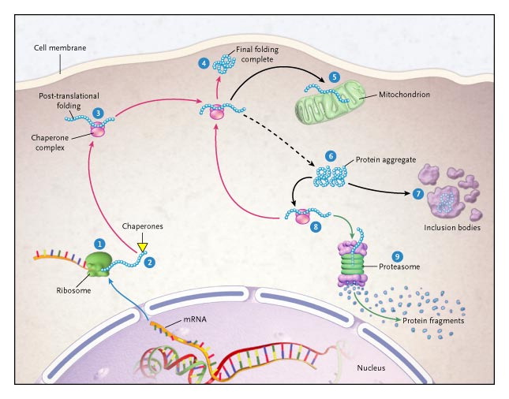
Macario AJ, de Macario EC. N Engl J Med 2005;353:1489-1501.
Diagram of the Life of a Protein.
Notes:
Figure 1. Diagram of the Life of a Protein. Translation of messenger RNA (mRNA) occurs on the ribosome (1). Folding of the nascent polypeptide begins, assisted by chaperones (2). The polypeptide proceeds to post-translational folding (3). The new protein is correctly folded into its tertiary structure (4). Some proteins are translocated into organelles, such as mitochondria (5). Unfolded and misfolded polypeptides aggrgate (6) and precipitate in an inclusion body (7). Unfolded or partially folded polypeptides are freed from the aggregates by chaperones (8) and refolded (4) or degraded in the proteasome (9). Red arrows denote the pathway toward folding. The black dashed arrow denotes the pathway toward unfolding and aggregation initiated by cell stressors. The green arrow denotes the pathway toward degradation. The pathway from step 8 to step 4 is very active in protein-misfolding disorders and offers a convenient target for devising therapeutic strategies based on the administration of chaperones or chaperone genes.

Slide 21
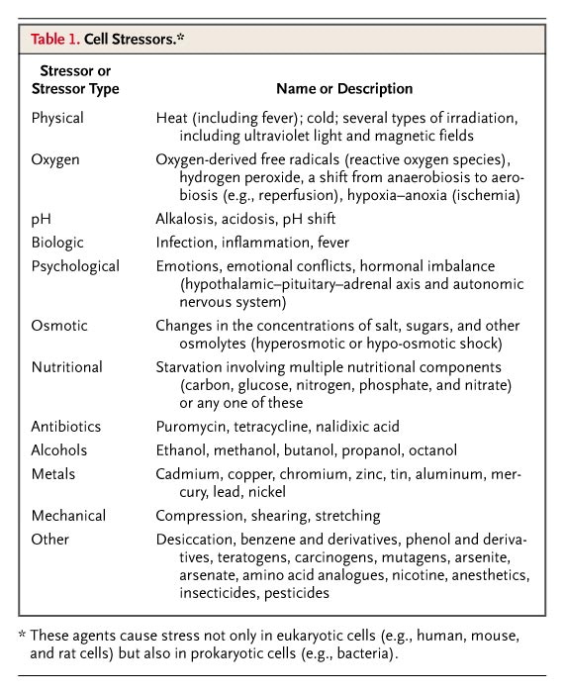
Macario AJ, de Macario EC. N Engl J Med 2005;353:1489-1501.
Cell Stressors.

Slide 22
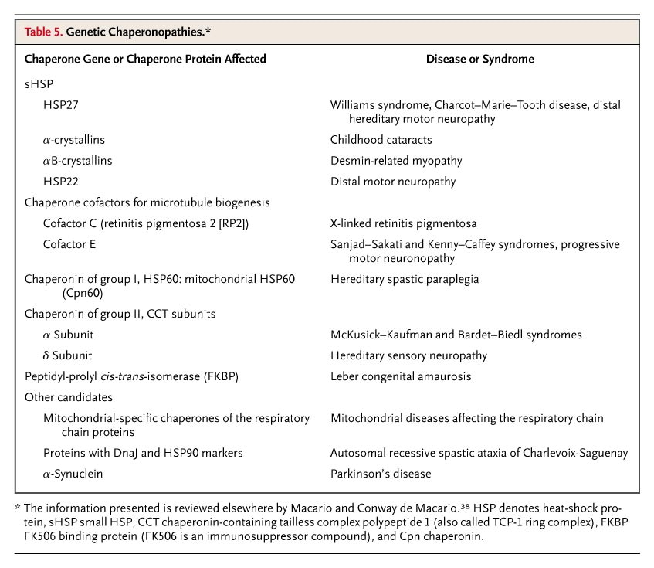
Macario AJ, de Macario EC. N Engl J Med 2005;353:1489-1501.
Genetic Chaperonopathies.

Slide 23
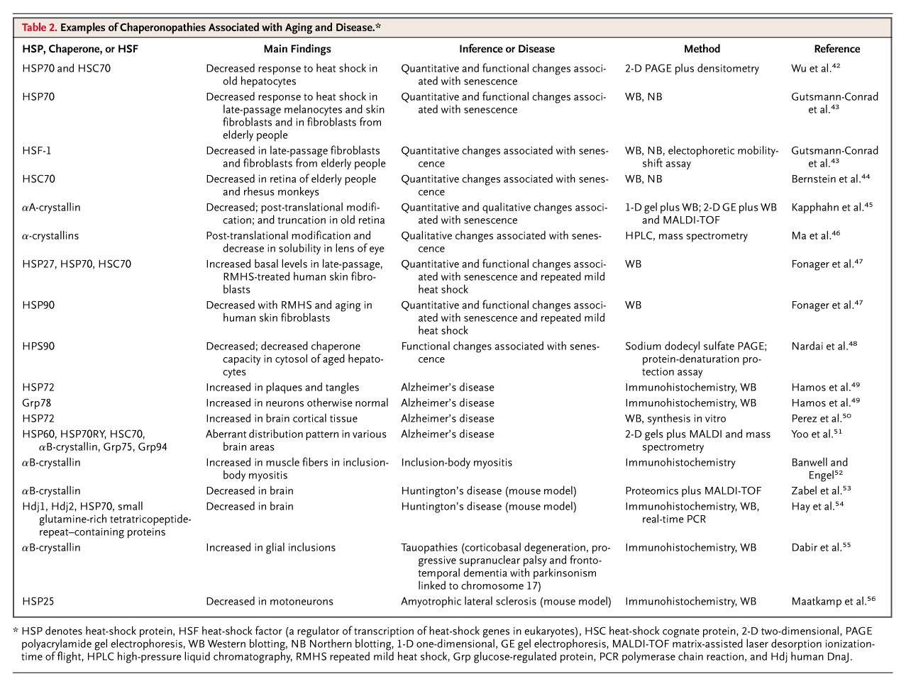
Macario AJ, de Macario EC. N Engl J Med 2005;353:1489-1501.
Examples of Chaperonopathies Associated with Aging and Disease.

Slide 24
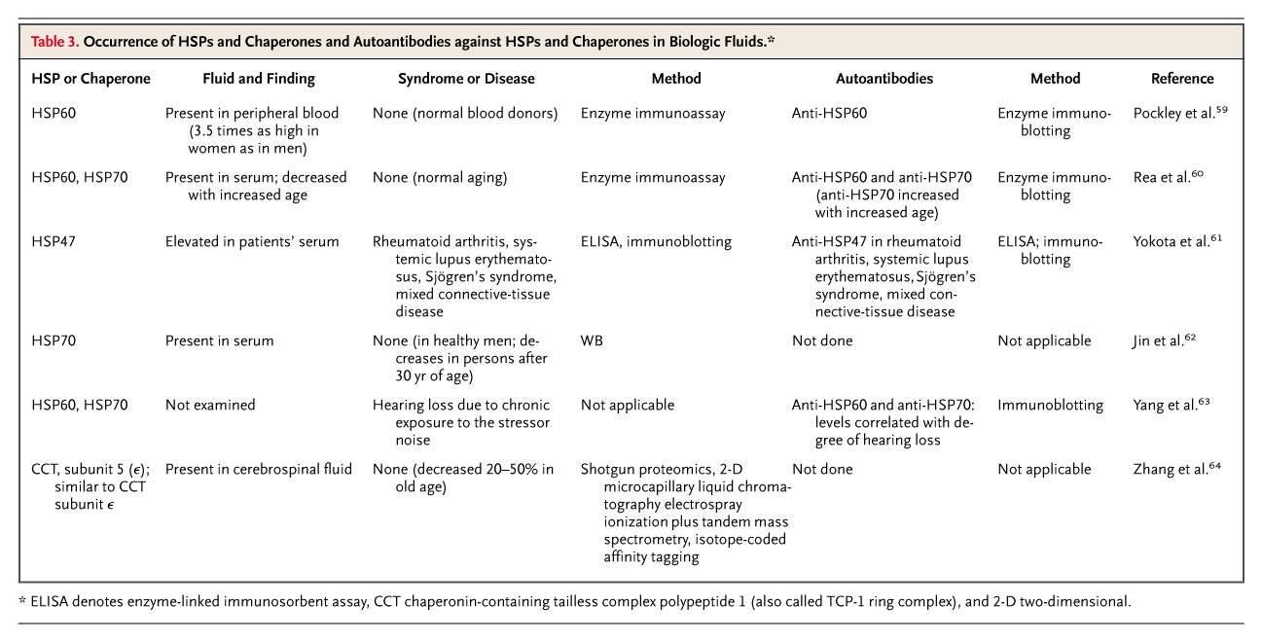
Macario AJ, de Macario EC. N Engl J Med 2005;353:1489-1501.
Occurrence of HSPs and Chaperones and Autoantibodies against HSPs and Chaperones in Biologic Fluids.

Slide 25
Geldanamycin blocks breast cancer cell proliferation (MTT assay)
Kim LS, Kim JH. Heat Shock Protein as Molecular Targets for Breast Cancer Therapeutics. Journal of Breast Cancer 2011;14(3):167-174. doi:10.4048/jbc.2011.14.3.167.

Slide 26
OVERVIEW
initially characterized as a highly conserved genes induced by heat shock.
prominent roles in many of the cell’s most basic processes.
molecular chaperones, stabilizing and assisting in the trafficking of nascent peptides
heat shock or hypoxia, increased expression of heat shock proteins protects the cell from proteotoxicity (Hightower) by stabilizing unfolded or misfolded peptides, giving the cell time to repair or re-synthesize damaged proteins.
general role as molecular chaperones (eg BiP)
aging, neurodegeneration, signaling, immunology and cancer.

Slide 27
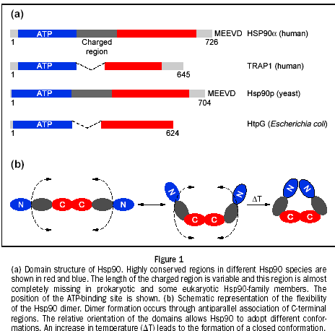
Heat shock Proteins (HSPs)
Heat shock proteins (HSP) are expressed in response to various biological stresses, including heat, high pressures, and toxic compounds. It is also one of the most abundant cellular proteins found under non-stress conditions
Hsp90 is part of a family of proteins known as "chaperones," which are solely dedicated to helping other proteins fold and assume their proper functions.
The chaperones Hsp70 and Hsp90 together with co-chaperones function to fold proteins in the cytoplasm. Sometimes Hsp70 and Hsp90 function sequentially to fold the same protein
Cells are vigilant about getting these folds right because misfolded proteins can change the normal life of the cell. In some cases change is good, in others deadly.
When HSP90 is compromised the number of morphological changes increases, which lead to formation of inactive or abnormally active polypeptides.
Domain structure of HSP90.

Slide 28
HSPs in protein folding
The diagram shows the role of heat-shock proteins and a chaperonin in protein folding. As the ribosome moves along the molecule of messenger RNA, a chain of amino acids is built up to form a new protein molecule. The chain is protected against unwanted interactions with other cytoplasmic molecules by heat-shock proteins and a chaperonin molecule until it has successfully completed its folding.
Source: (http://www.cs.stedwards.edu/chem/Chemistry/CHEM43/CHEM43/HSP/FUNCTION.HTML)

Slide 29
Extracellular Heat Shock Protein (Hsp)70 and Hsp90α Assist in Matrix Metalloproteinase-2 Activation and Breast Cancer Cell Migration and Invasion Jessica D. Sims, Jessica McCready, and Daniel G. Jay
Goals of the study
Understand migration and invasion, early steps in metastasis
Hsp90a was identified as critical to MMP-2 activation
Intracellular Hsp90α commonly functions with a complex of co-chaperones, leading to hypothesis that Hsp90α functions similarly outside of the cell
findings support a model in which MMP-2 activation by an extracellular co-chaperone complex mediated by Hsp90α increases breast cancer cell migration

Slide 30
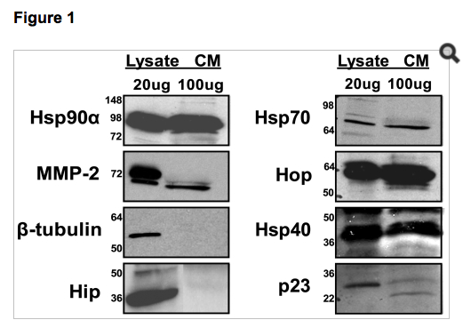
Hsp90α, MMP-2 and several co-chaperones are present in the conditioned media of breast cancer cells. Lysate and conditioned media were collected from MDA-MB-231 cells. 20 µg of protein was loaded into each lysate lane and 80 µg of protein was loaded into each conditioned media lane and immunoblotted for the Hsp90α, MMP-2, Hsp70, Hop, Hsp40, p23, Hip, and β-tubulin. The first six proteins were found to be present in both the cell lysate and in the conditioned media, while Hip was only found in the lysate. β-tubulin was used as a negative control. The molecular weight markers are indicated on the left.

Slide 31
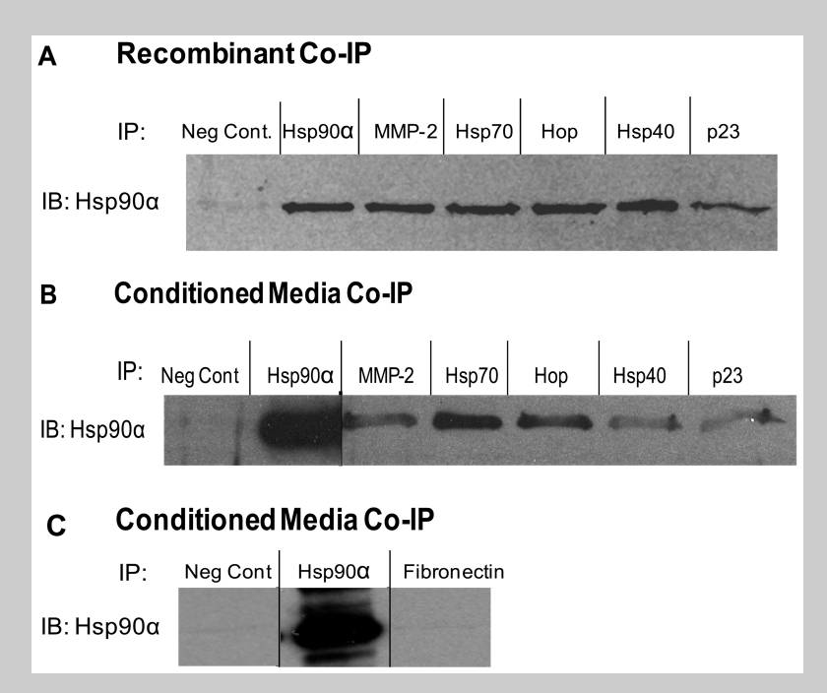
Fig 2 Hsp90α, MMP-2, Hsp70, Hop, Hsp40, and p23 interact in vitro and outside of the cell.

Slide 32
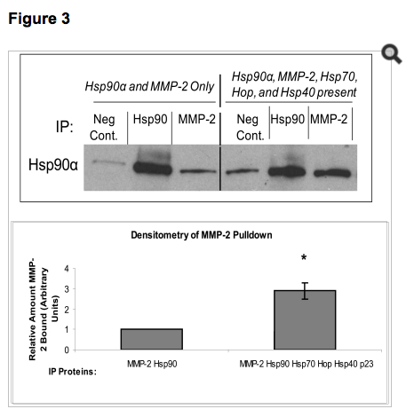
Fig 3: The presence of Hsp70, Hop, Hsp40, and p23 increase the interaction between Hsp90α and MMP-2.

Slide 33
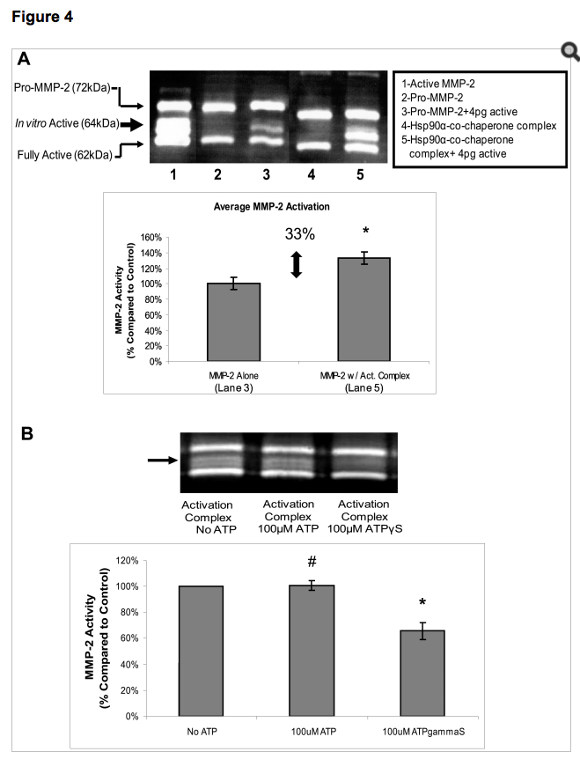
Figure 4: Hsp90α and co-chaperones Hsp70, Hop, Hsp40, and p23 are sufficient to activate MMP-2 in vitro.

Slide 34
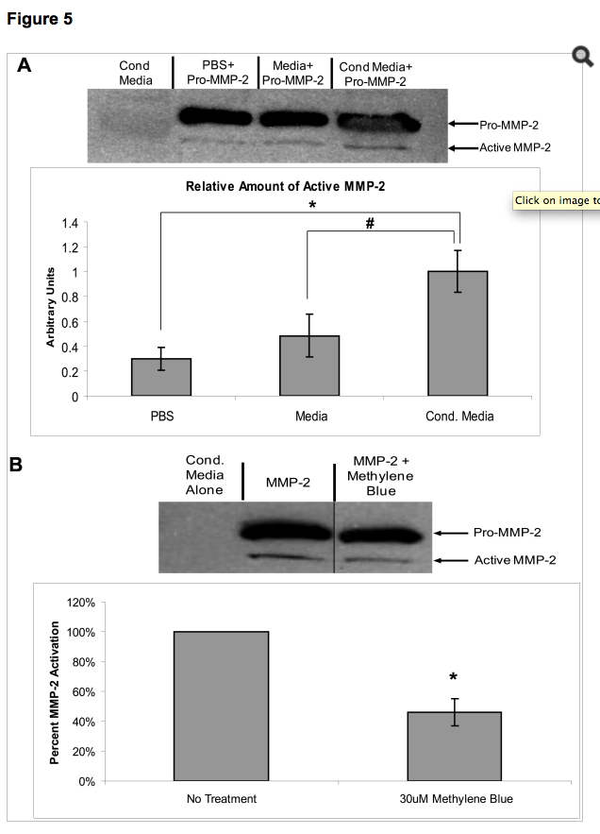
Figure 5: Conditioned media from cancer cells contains necessary components to activate MMP-2.

Slide 35
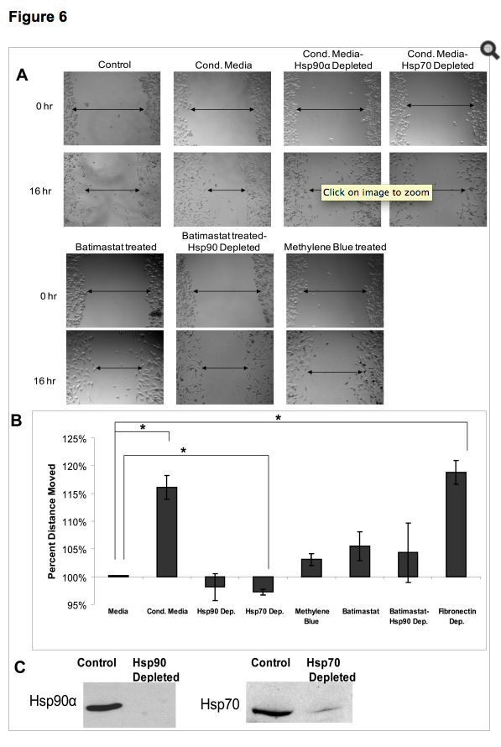
Figure 6: Hsp90α and its co-chaperone complex assist in wound healing

Slide 36
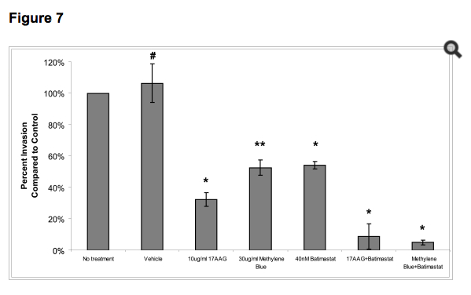
Fig 7: Inhibiting Hsp70 reduces breast cancer cell invasion in vitro.

Slide 37
Improved targeting of JAK2 leads to increased therapeutic efficacy in myeloproliferative neoplasms
Neha Bhagwat, Priya Koppikar, Matthew Keller, Sachie Marubayashi, Kaitlyn Shank, Raajit Rampal, Jun Qi, Maria Kleppe, Hardik J. Patel, Smit K. Shah, Tony Taldone, James E. Bradner, Gabriela Chiosis, and Ross L. Levine
DOI 10.1182/blood-2014-01-547760.

Slide 38
“Key points”
Genetic deletion of JAK2 in vivo shows that MPN cells remain fully dependent on JAK2 signaling for survival.
• Dual JAK2 targeting with JAK and HSP90 inhibitors offers increased efficacy in murine models and primary samples.

Slide 39
mice
Jak2f/f mice were a kind gift from Kay-Uwe Wagner (University of
Nebraska Medical Center, Omaha, NE).14 They were backcrossed into
C57BL/6 for 7 generations and then crossed to C57BL/6 Mx1-Cre mice.

Slide 40
Myeloproliferative neoplasms
A type of disease in which the bone marrow makes too many red blood cells, platelets, or certain white blood cells. Myeloproliferative neoplasms usually get worse over time as the number of extra cells build up in the blood and/or bone marrow. This may cause bleeding problems, anemia, infection, fatigue, or other signs and symptoms. Certain myeloproliferative neoplasms may become acute myeloid leukemia (AML).
Myeloproliferative neoplasms include chronic myelogenous leukemia (CML), polycythemia vera, primary myelofibrosis, essential thrombocythemia, chronic neutrophilic leukemia, and chronic eosinophilic leukemia. Also called chronic myeloproliferative neoplasm.
http://www.cancer.gov/cancertopics/types/myeloproliferative

Slide 42
JAK2 exon 12 mutationsare observed in JAK2V617F-negative PV5 and mutations in thethrombopoietin receptor (MPLW515L/K/A) are observed in JAK2V617F-negative ET/PMF. These mutations result in constitutive
activation of the Janus kinase–signal transducer and activator oftranscription (JAK-STAT) signaling pathway and their identificationled to the clinical development of JAK kinase inhibitors for MPN patients
In 2011, the dual JAK1/JAK2 inhibitor INCB18424 (ruxolitinib; Jakafi) was approved for the treatment of myelofibrosis (MF) based on the ability of ruxolitinib to arkedly reduce splenomegaly and ameliorate MF-associated symptoms

Slide 43
PU-H71 identifies the aberrant signalosome in CML cells.
Affinity-based proteomics reveal cancer-specific networks coordinated by Hsp90
Kamalika Moulick, James H Ahn, Hongliang Zong, Anna Rodina, Leandro Cerchietti, Erica M Gomes DaGama, Eloisi Caldas-Lopes, Kristin Beebe, Fabiana Perna, Katerina Hatzi, Ly P Vu, Xinyang Zhao, Danuta Zatorska, Tony Taldone, Peter Smith-Jones, Mary Alpaugh, Steven S Gross, Nagavarakishore Pillarsetty, Thomas Ku, Jason S Lewis, Steven M Larson, Ross Levine, Hediye Erdjument-Bromage, Monica L Guzman, Stephen D Nimer et al.
Nature Chemical Biology 7, 818–826 (2011) doi:10.1038/nchembio.670

Slide 44
Tissue-specific knockouts
Cre-Lox system
Cre recombinase snips out DNA between LoxP sites
A tissue-specific promoter in front of Cre produces tissue-specific snipping
Tissue-specific promoter
Cre
Transgenic mouse
e.g. L7 (Purkinje)
CaMKII (forebrain)
Cre
X
Cre
LoxP sites and everything in between them is excised
Exon 1
Exon 2
Exon 2
Knockout only in promoter region

Slide 45
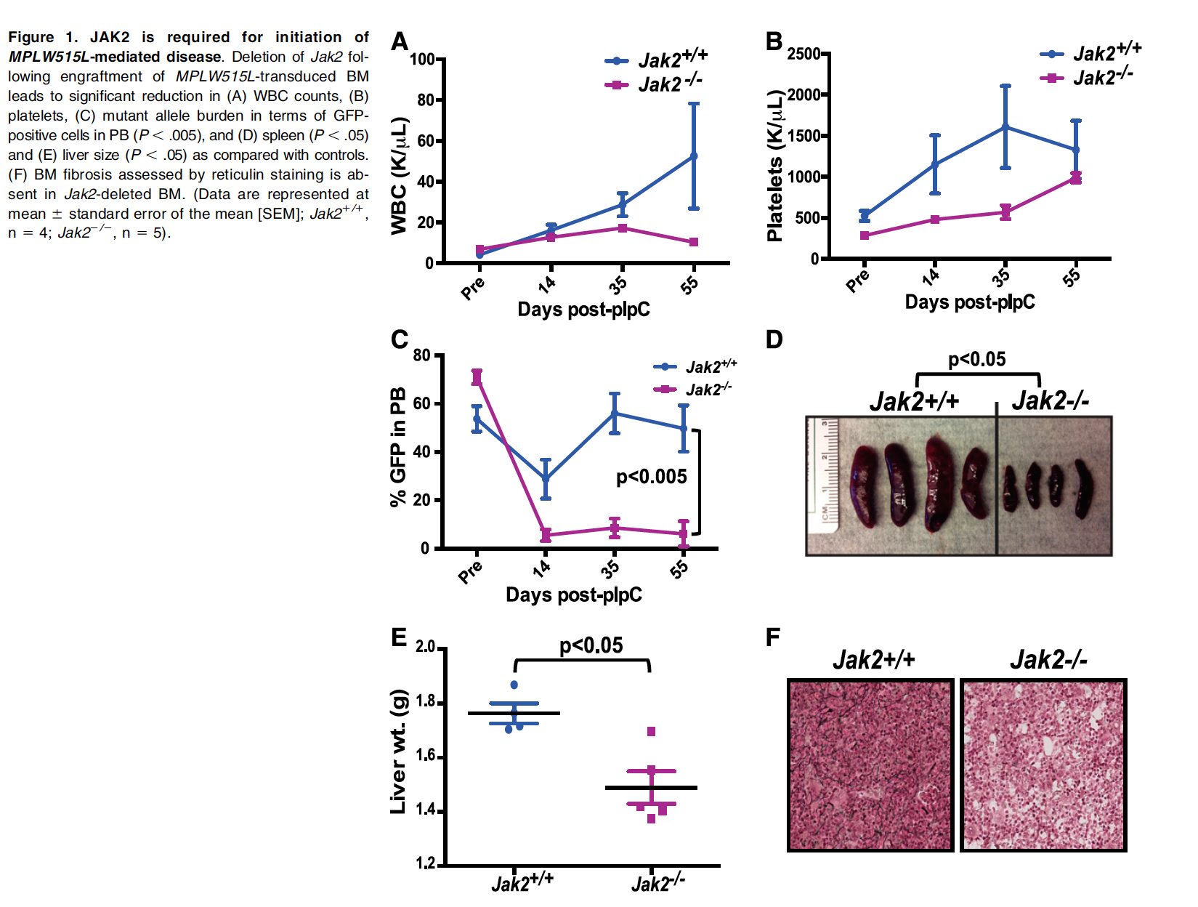

Slide 46
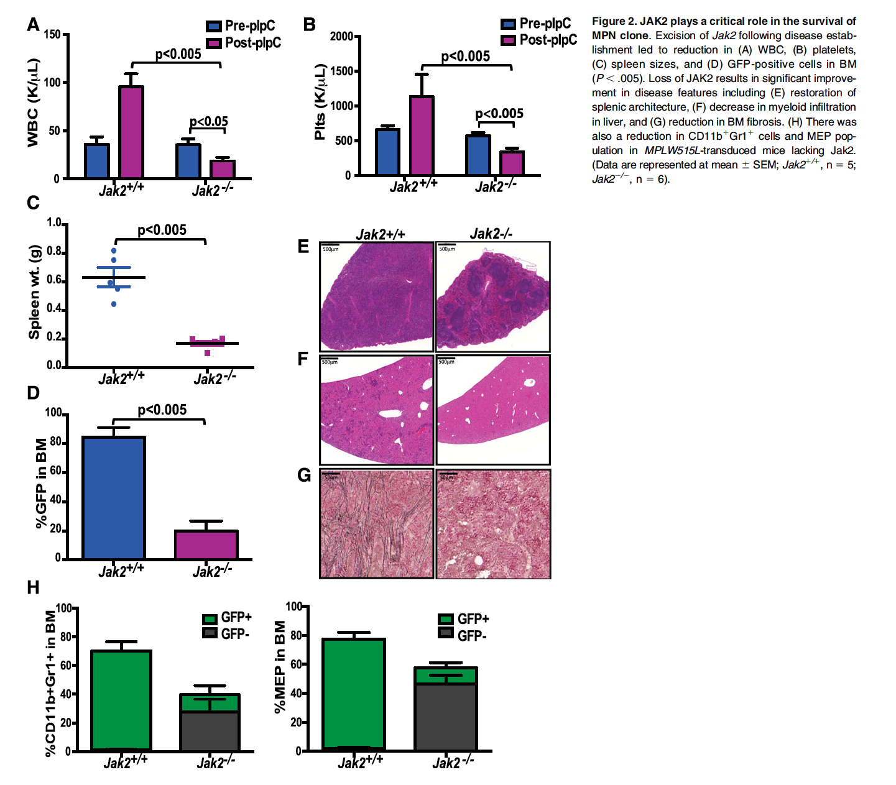

Slide 47
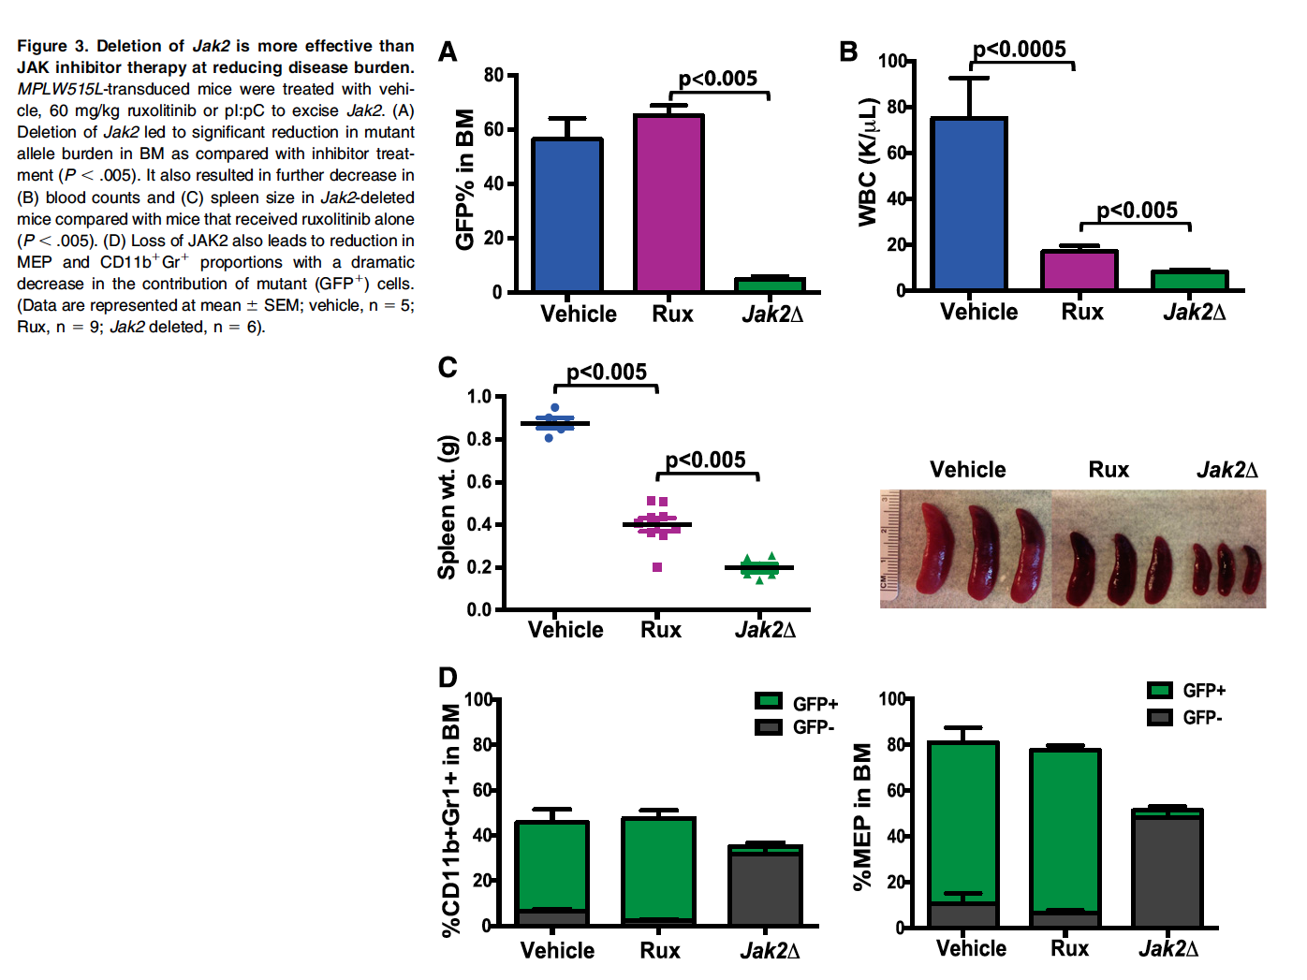

Slide 48
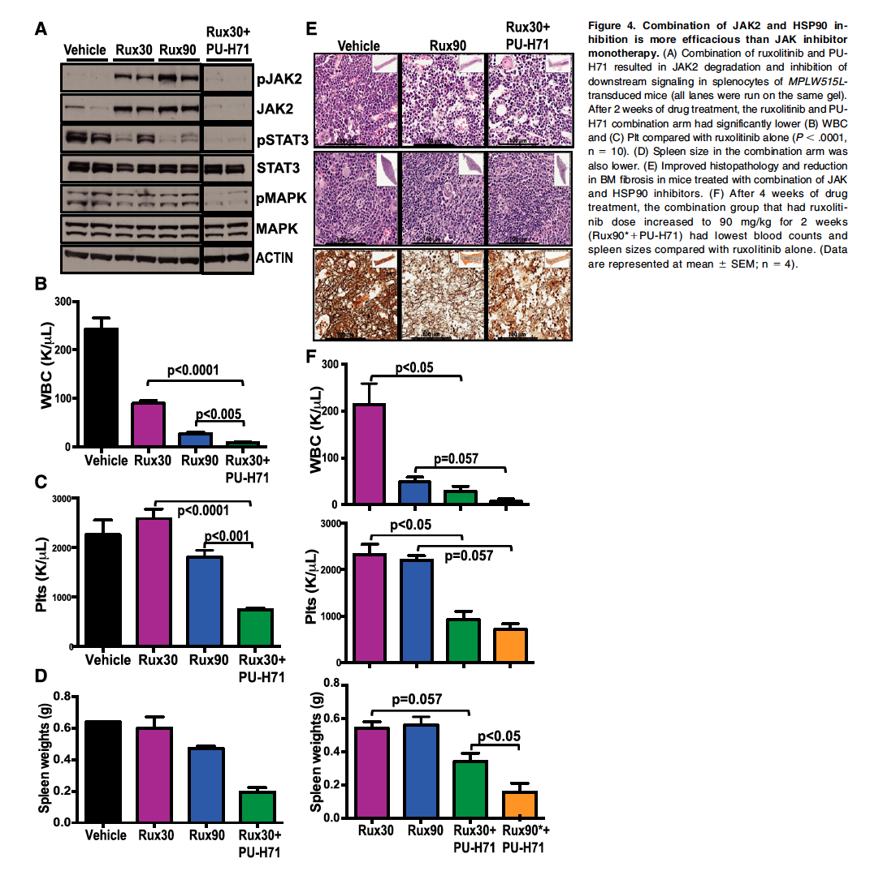

Slide 49
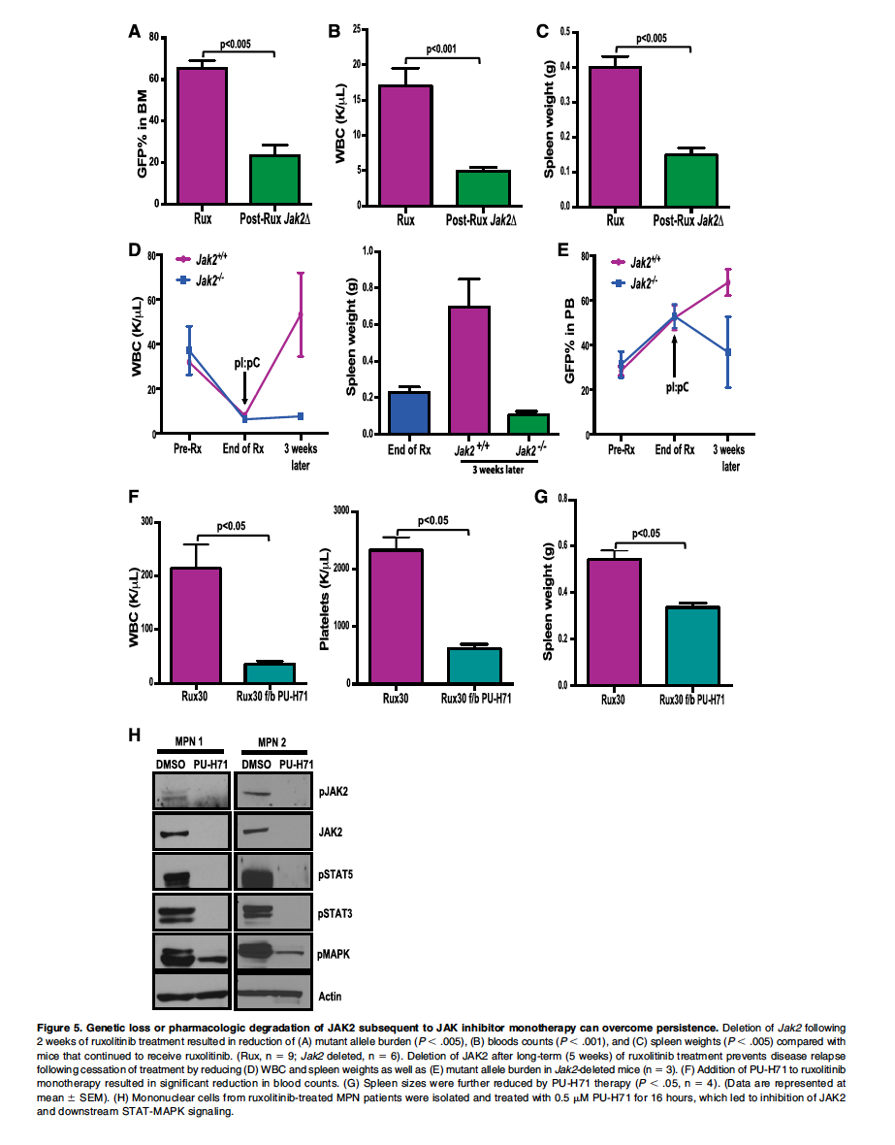

Slide 50
